Slide 1
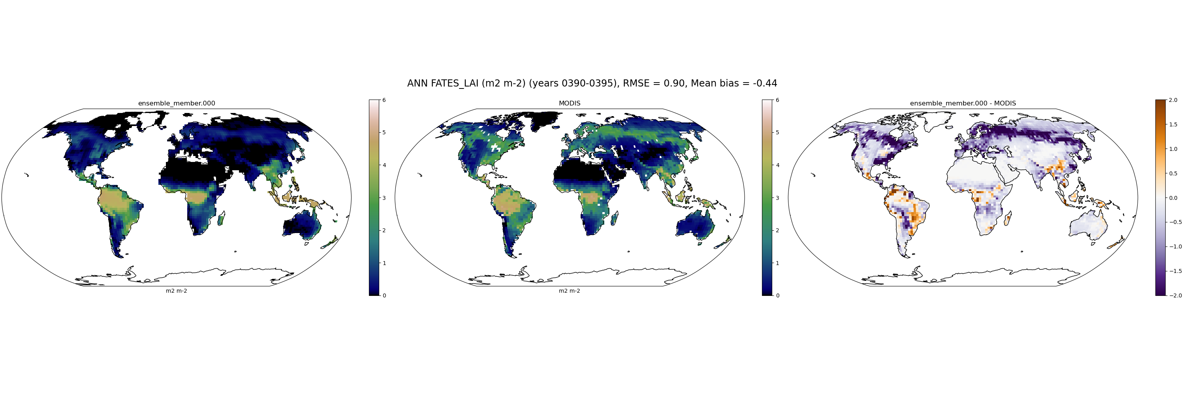
LAI_MODIS
000

Slide 2

LAI_MODIS
003

Slide 3

LAI_MODIS
005

Slide 4

LAI_MODIS
009

Slide 5

LAI_MODIS
019

Slide 6

LAI_MODIS
021

Slide 7

LAI_MODIS
024

Slide 8

LAI_MODIS
030

Slide 9

LAI_MODIS
032

Slide 10

LAI_MODIS
039

Slide 11

LAI_MODIS
041

Slide 12

LAI_MODIS
042

Slide 13
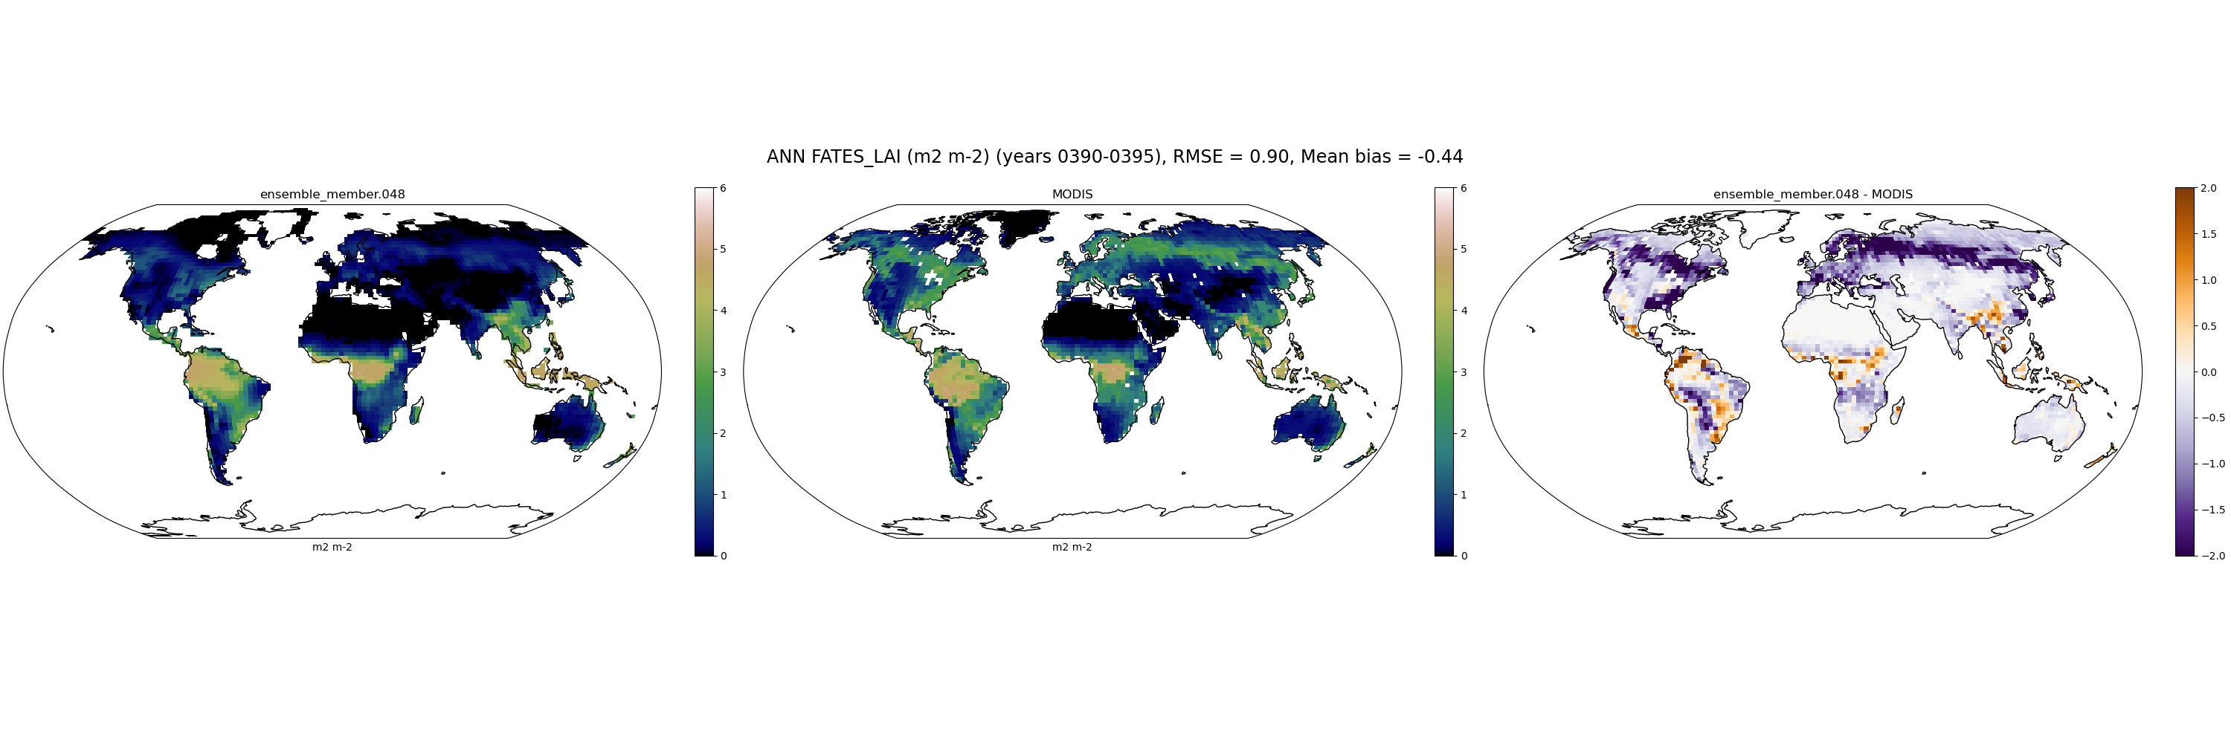
LAI_MODIS
048

Slide 14

LAI_MODIS
058

Slide 15

LAI_MODIS
059

Slide 16

LAI_MODIS
064

Slide 17

LAI_MODIS
065

Slide 18

LAI_MODIS
069

Slide 19

LAI_MODIS
072

Slide 20

LAI_MODIS
073

Slide 21
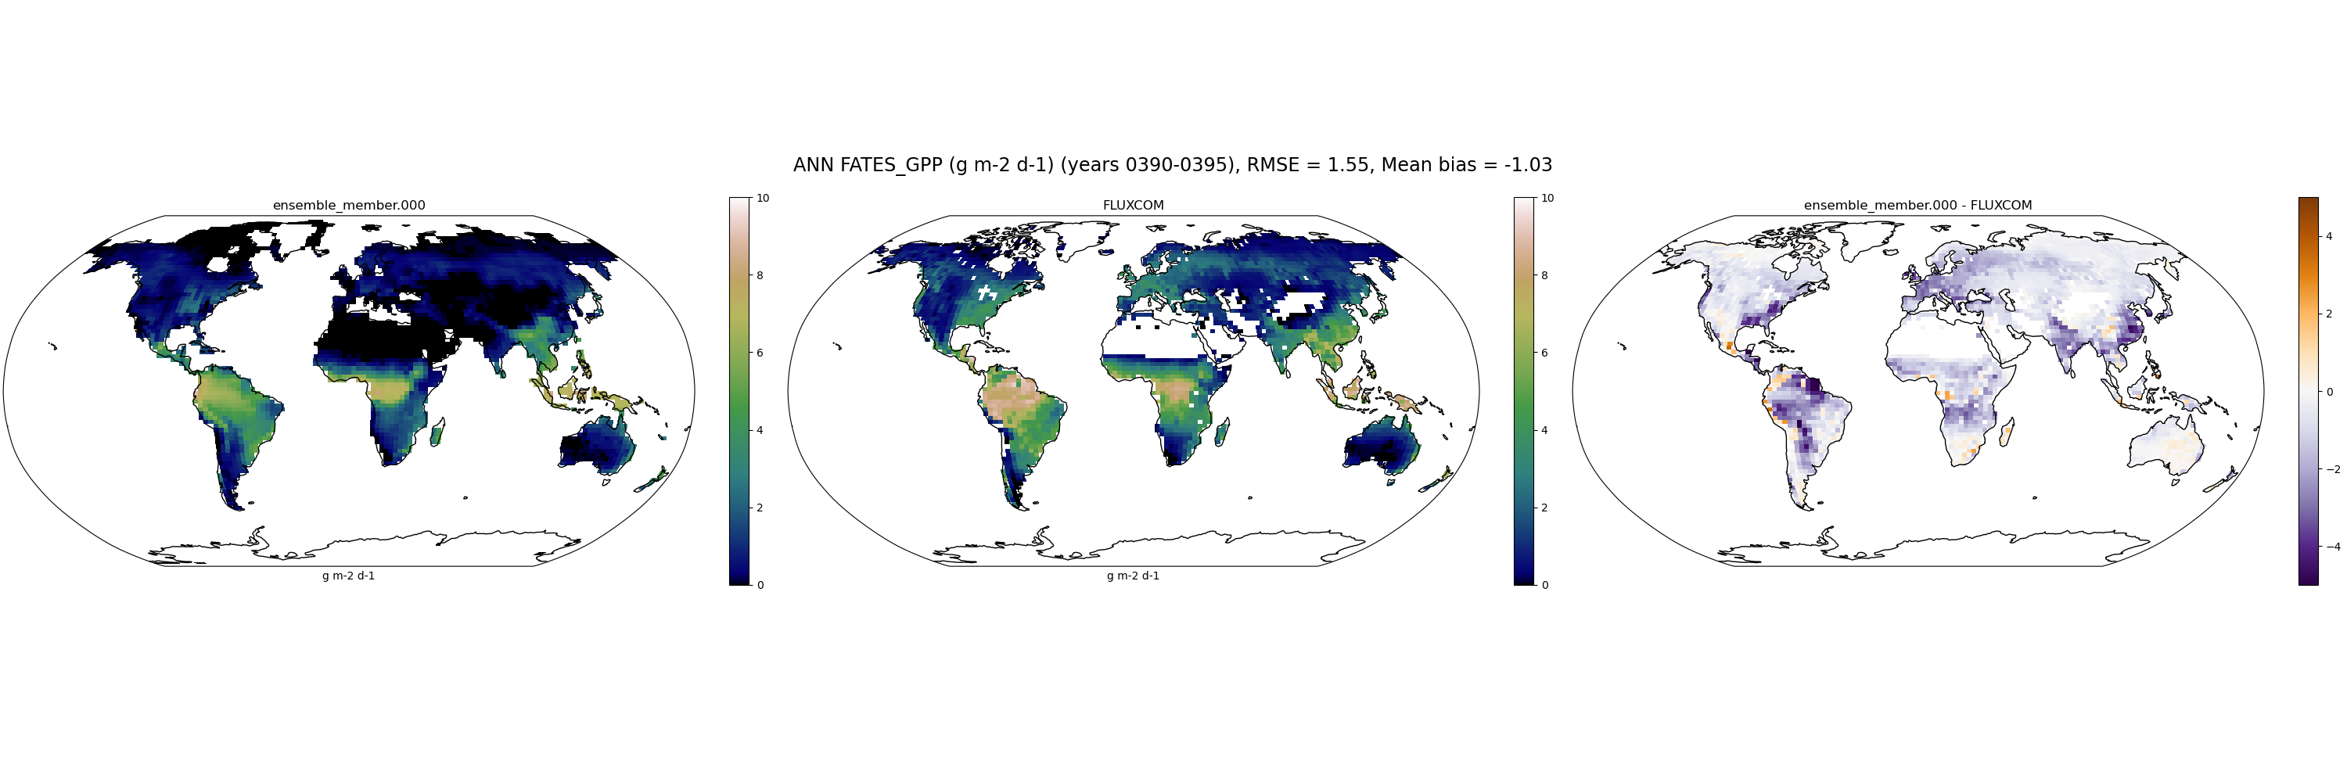
FATES_GPP_FLUXCOM
000

Slide 22
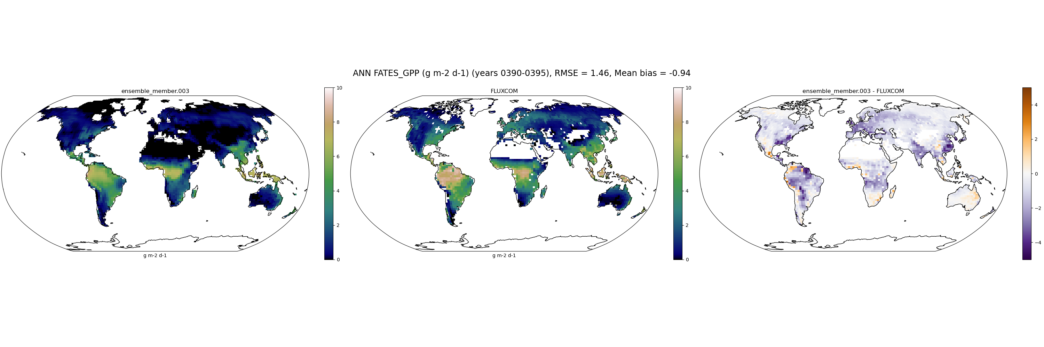
FATES_GPP_FLUXCOM
003

Slide 23

FATES_GPP_FLUXCOM
005

Slide 24
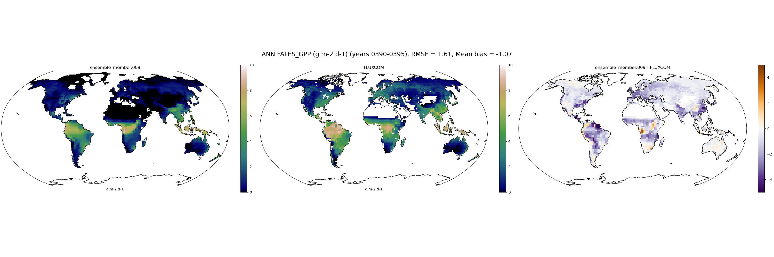
FATES_GPP_FLUXCOM
009

Slide 25

FATES_GPP_FLUXCOM
019

Slide 26

FATES_GPP_FLUXCOM
021

Slide 27

FATES_GPP_FLUXCOM
024

Slide 28

FATES_GPP_FLUXCOM
030

Slide 29
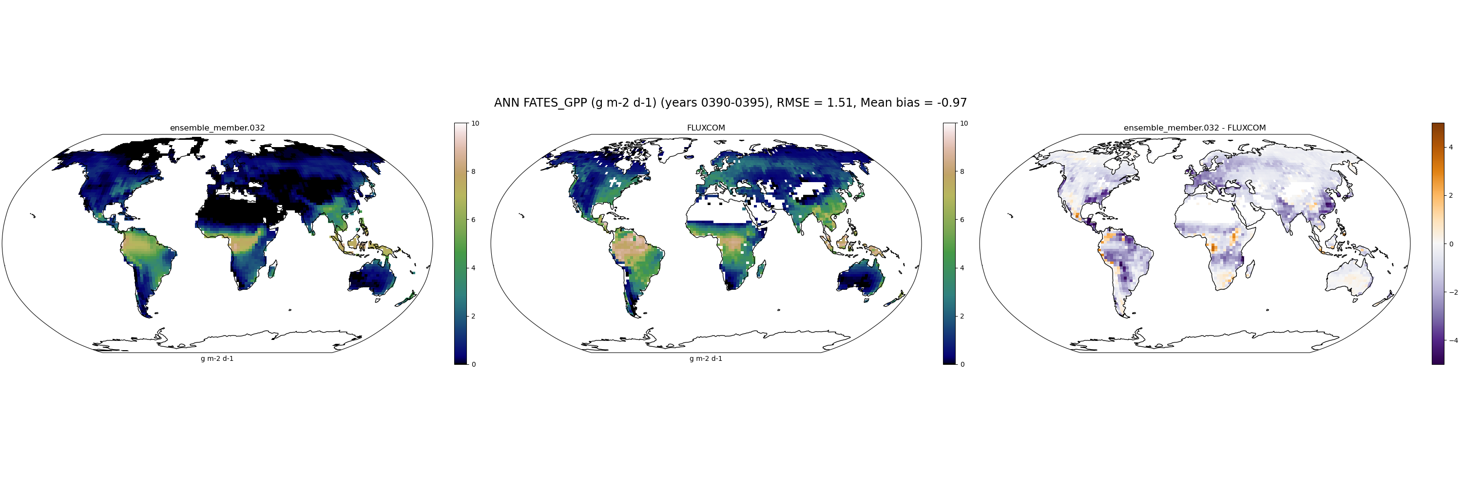
FATES_GPP_FLUXCOM
032

Slide 30

FATES_GPP_FLUXCOM
039

Slide 31

FATES_GPP_FLUXCOM
041

Slide 32

FATES_GPP_FLUXCOM
042

Slide 33

FATES_GPP_FLUXCOM
048

Slide 34

FATES_GPP_FLUXCOM
058

Slide 35

FATES_GPP_FLUXCOM
059

Slide 36

FATES_GPP_FLUXCOM
064

Slide 37

FATES_GPP_FLUXCOM
065

Slide 38

FATES_GPP_FLUXCOM
069

Slide 39

FATES_GPP_FLUXCOM
072

Slide 40

FATES_GPP_FLUXCOM
073

Slide 41
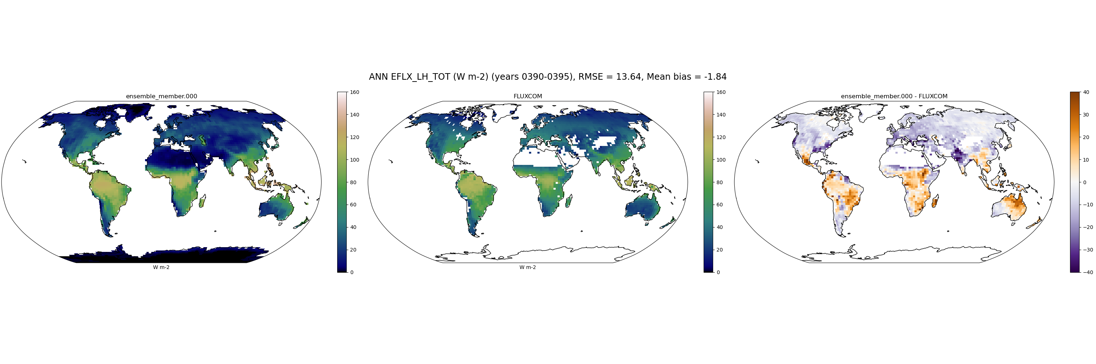
EFLX_LH_TOT_FLUXCOM
000

Slide 42
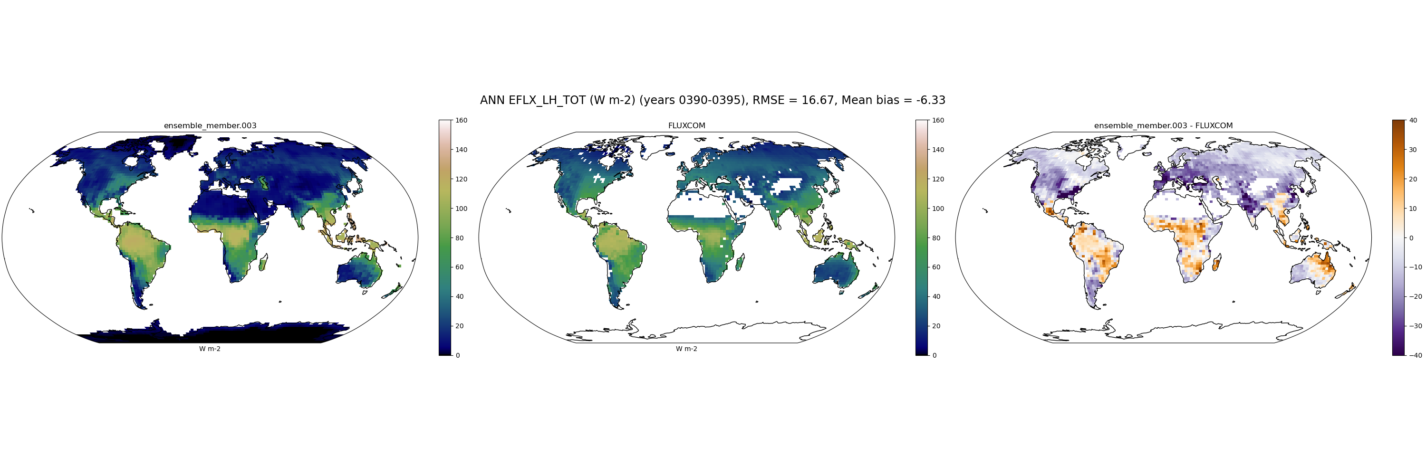
EFLX_LH_TOT_FLUXCOM
003

Slide 43
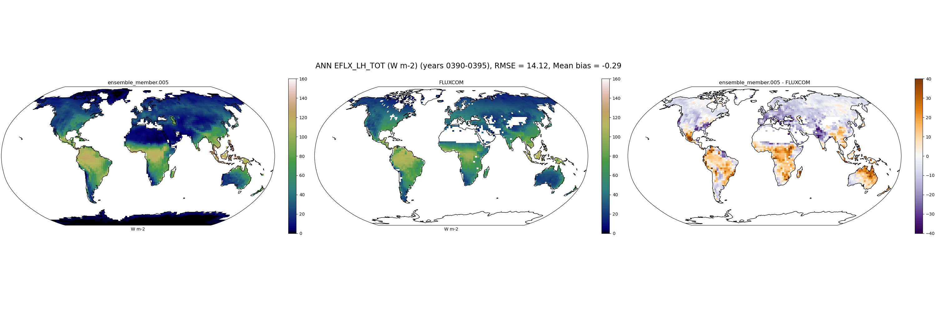
EFLX_LH_TOT_FLUXCOM
005

Slide 44
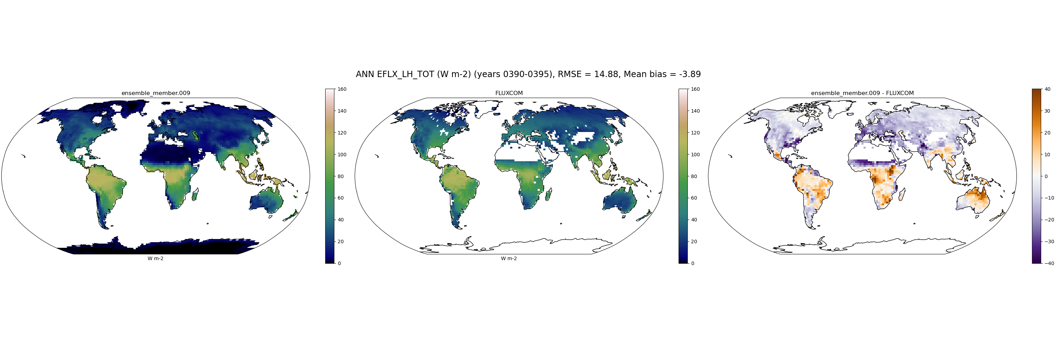
EFLX_LH_TOT_FLUXCOM
009

Slide 45
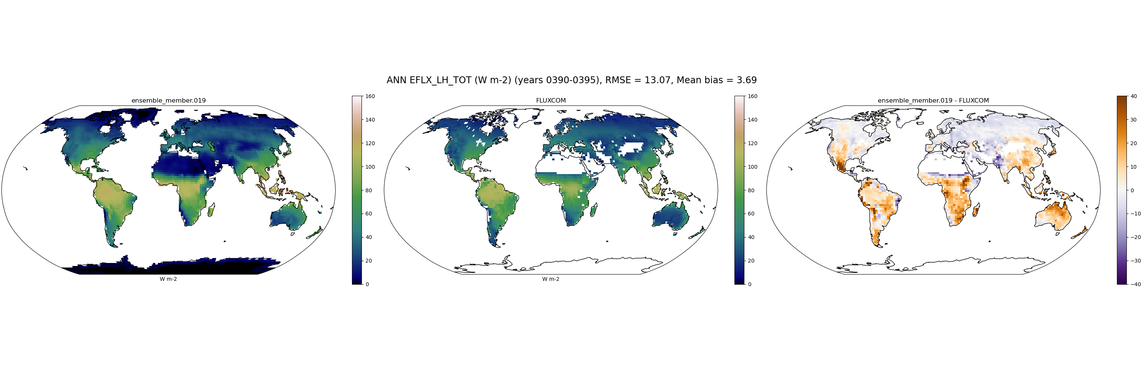
EFLX_LH_TOT_FLUXCOM
019

Slide 46

EFLX_LH_TOT_FLUXCOM
021

Slide 47
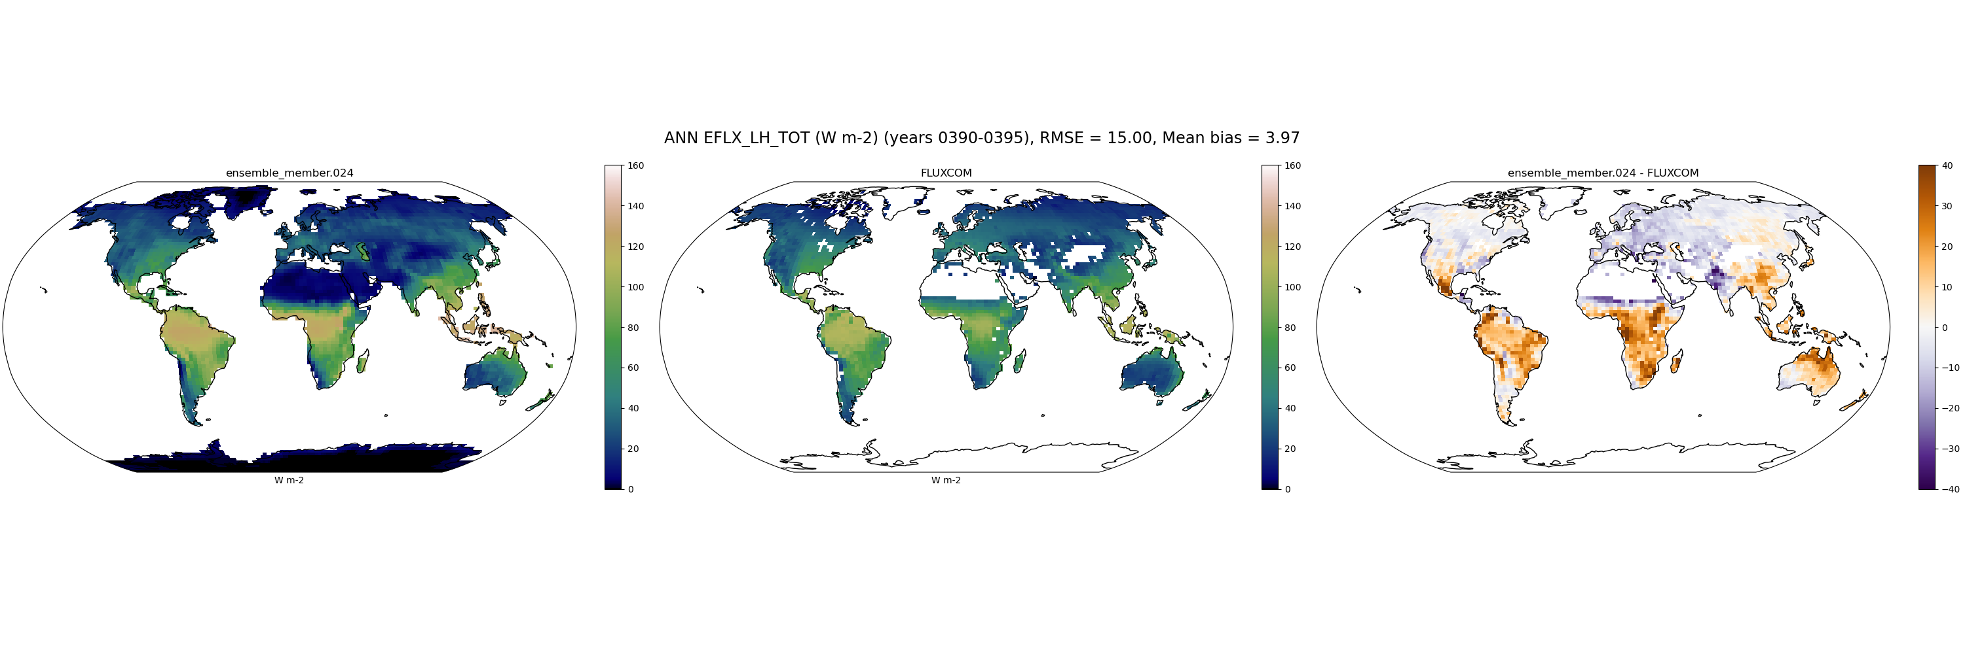
EFLX_LH_TOT_FLUXCOM
024

Slide 48
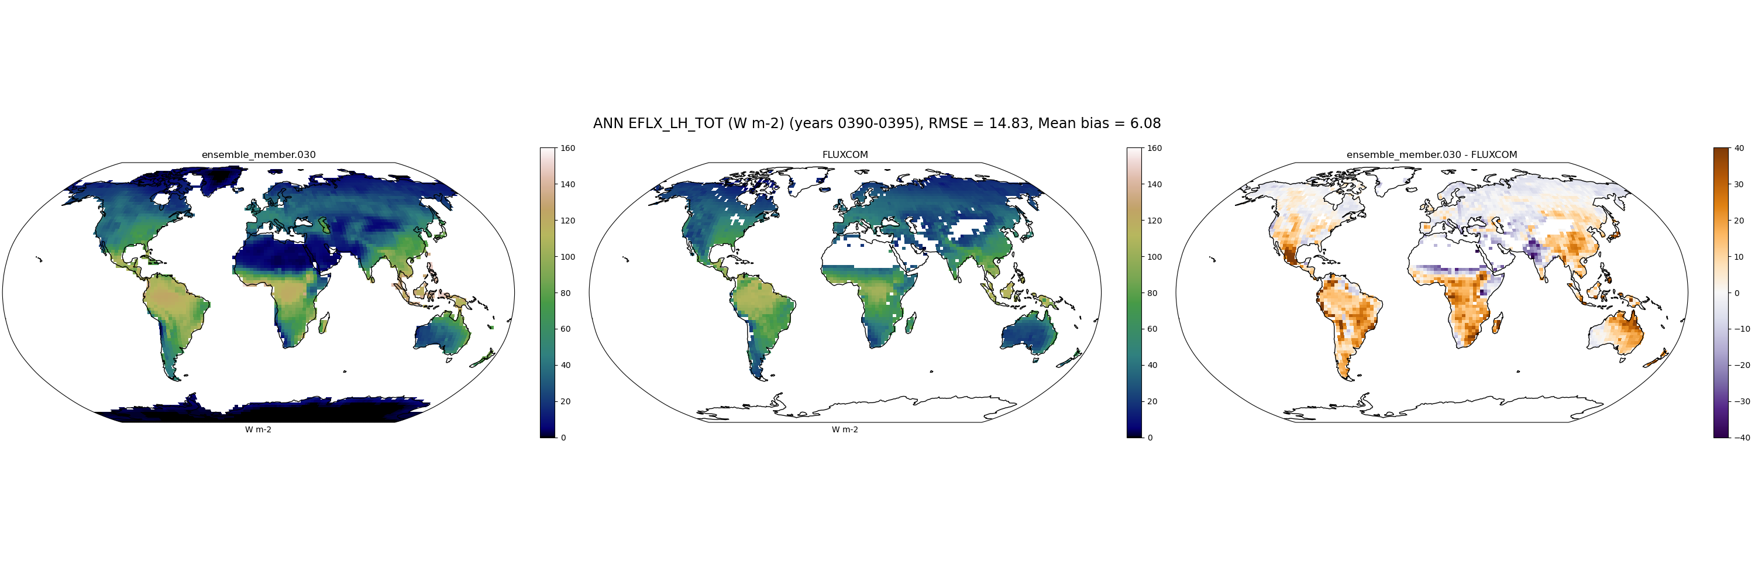
EFLX_LH_TOT_FLUXCOM
030

Slide 49
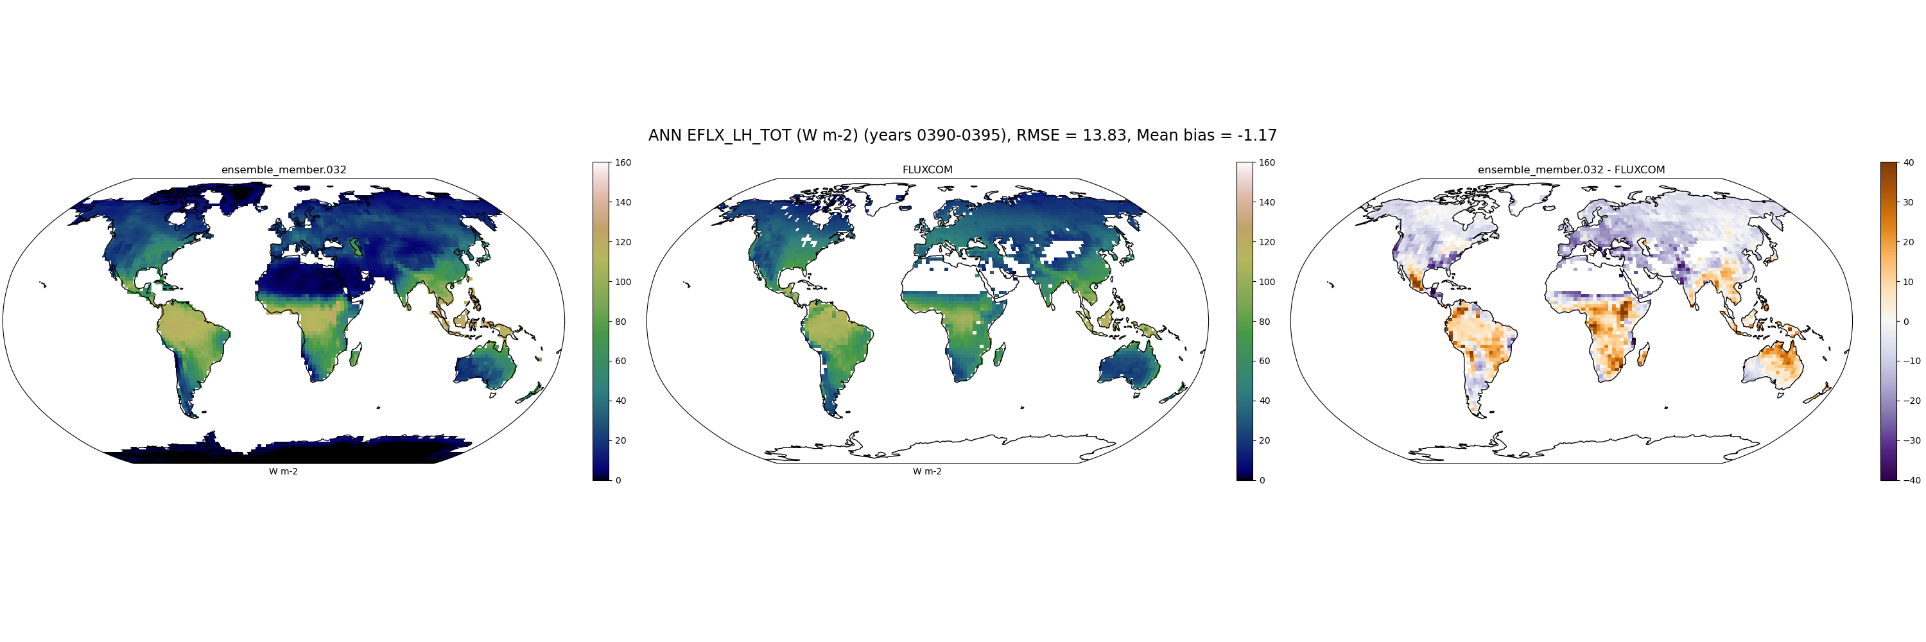
EFLX_LH_TOT_FLUXCOM
032

Slide 50
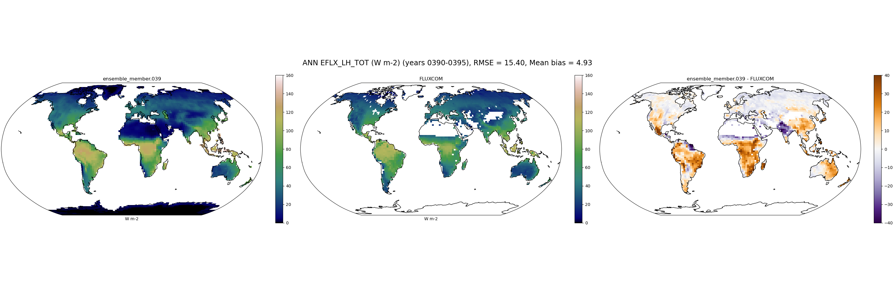
EFLX_LH_TOT_FLUXCOM
039

Slide 51
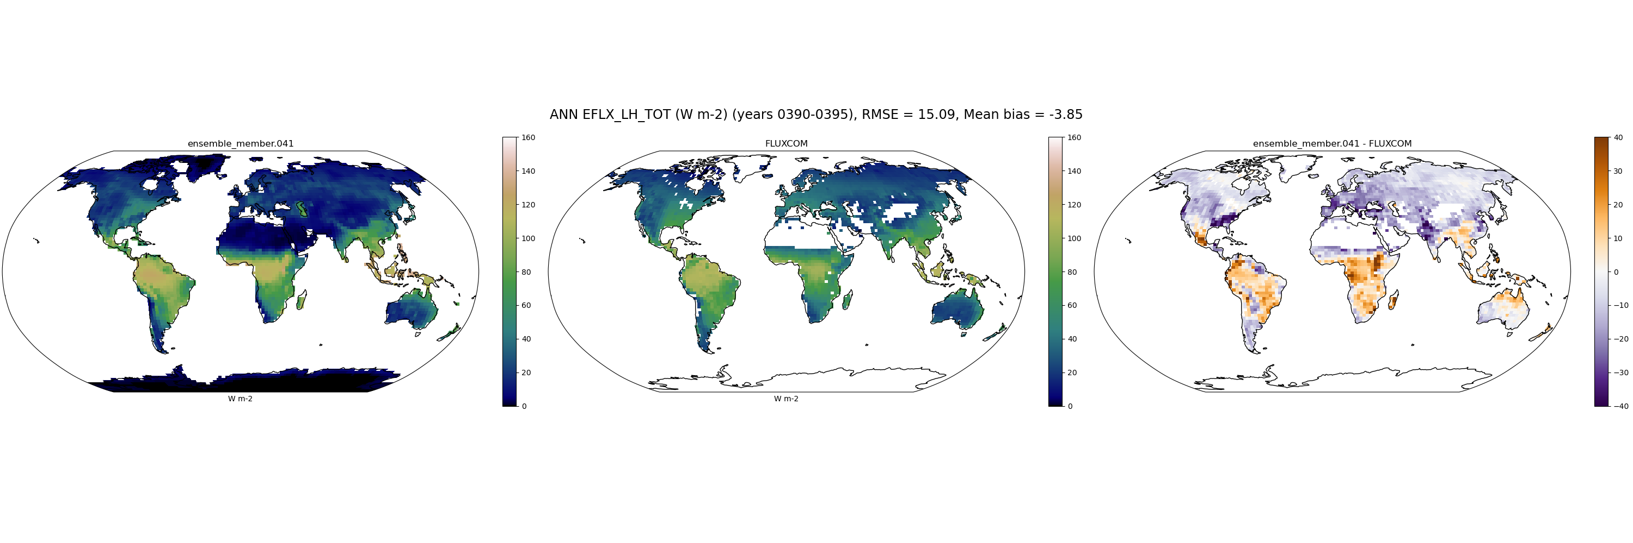
EFLX_LH_TOT_FLUXCOM
041

Slide 52
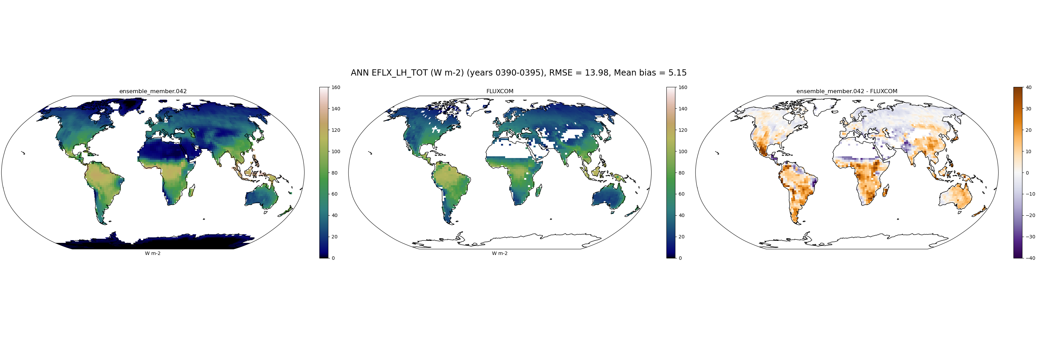
EFLX_LH_TOT_FLUXCOM
042

Slide 53
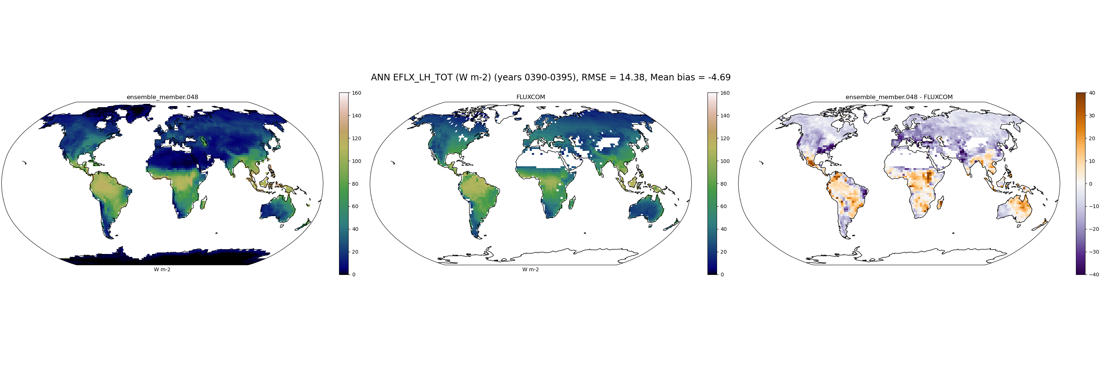
EFLX_LH_TOT_FLUXCOM
048

Slide 54
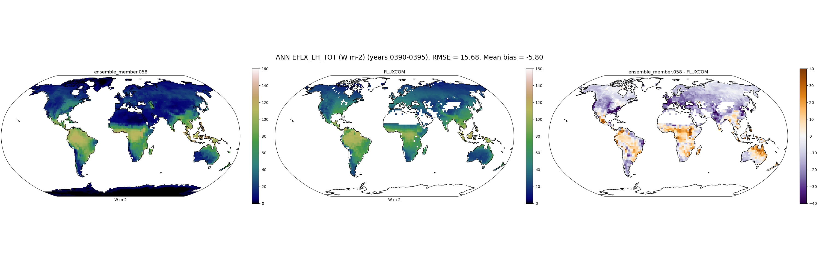
EFLX_LH_TOT_FLUXCOM
058

Slide 55
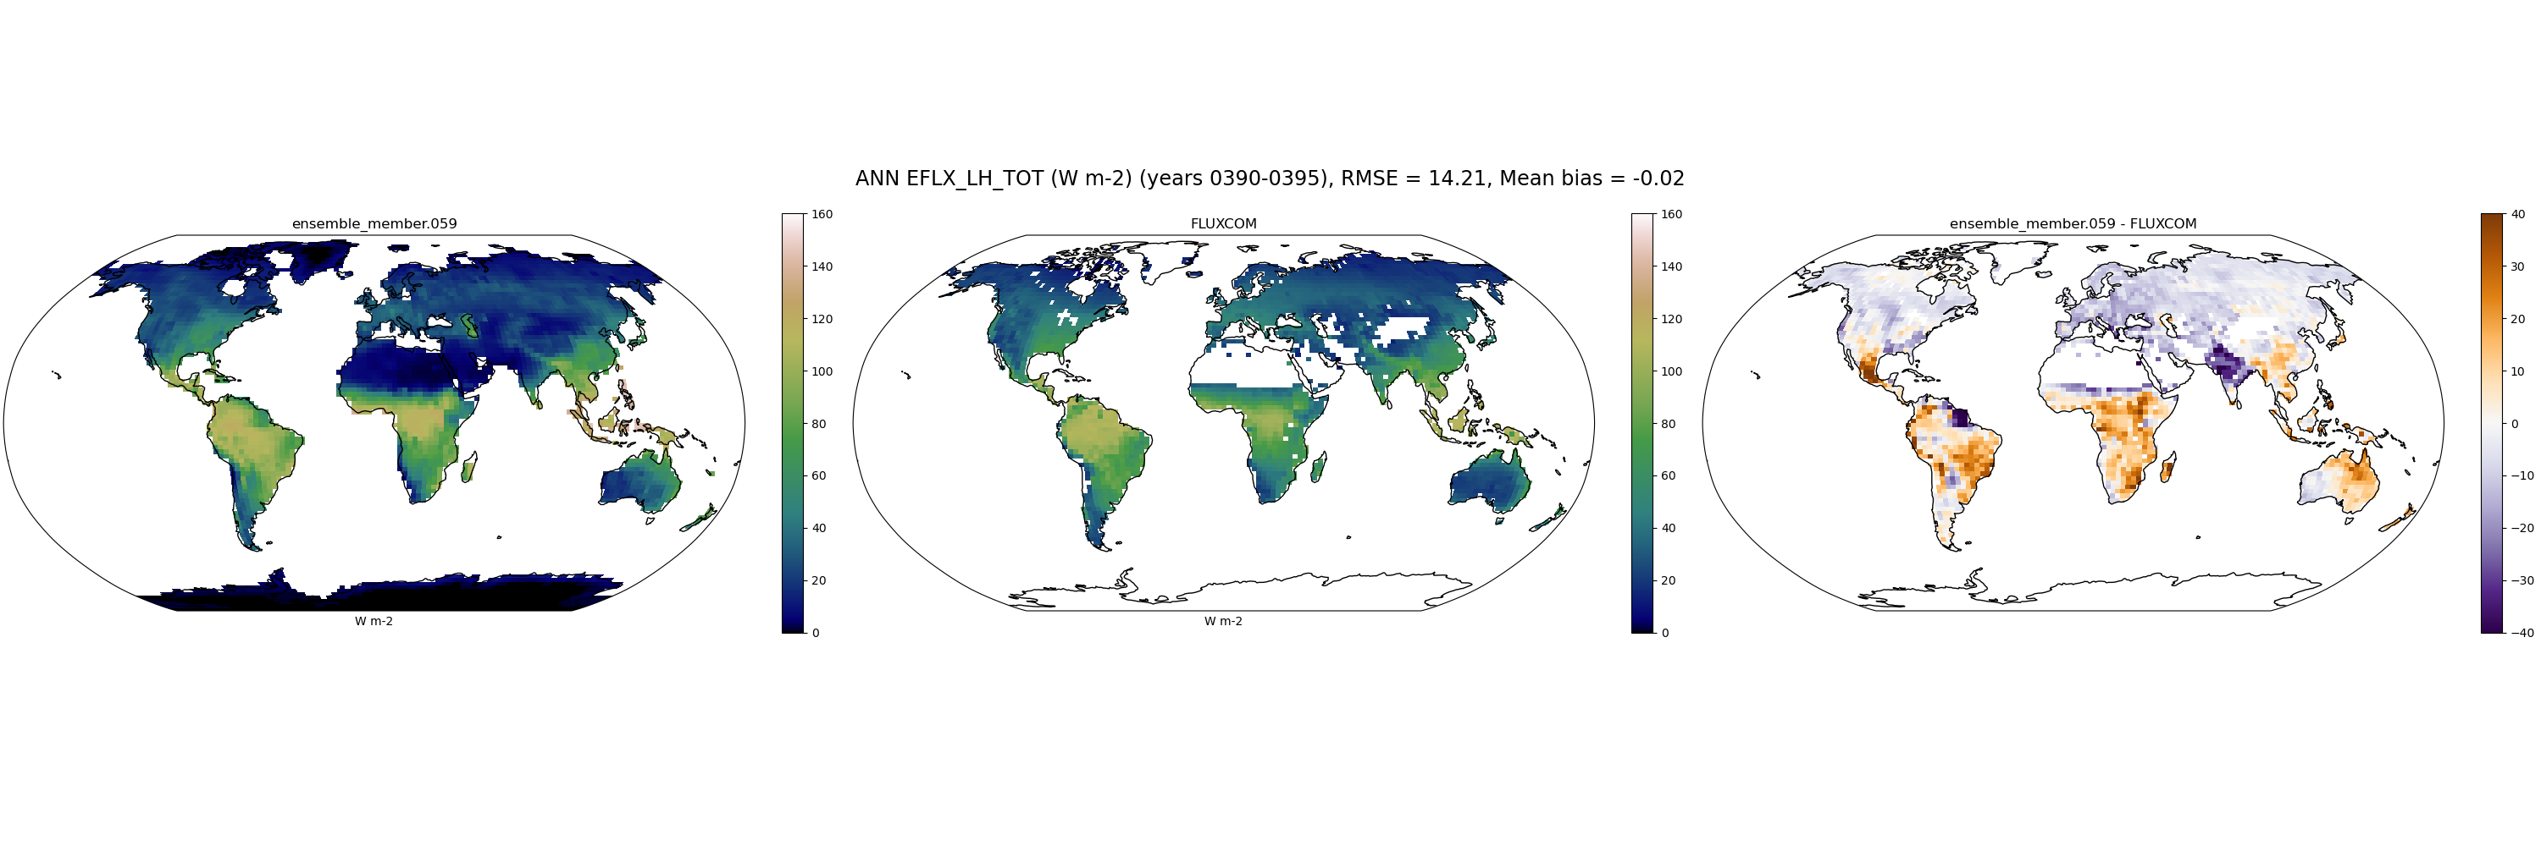
EFLX_LH_TOT_FLUXCOM
059

Slide 56

EFLX_LH_TOT_FLUXCOM
064

Slide 57

EFLX_LH_TOT_FLUXCOM
065

Slide 58

EFLX_LH_TOT_FLUXCOM
069

Slide 59
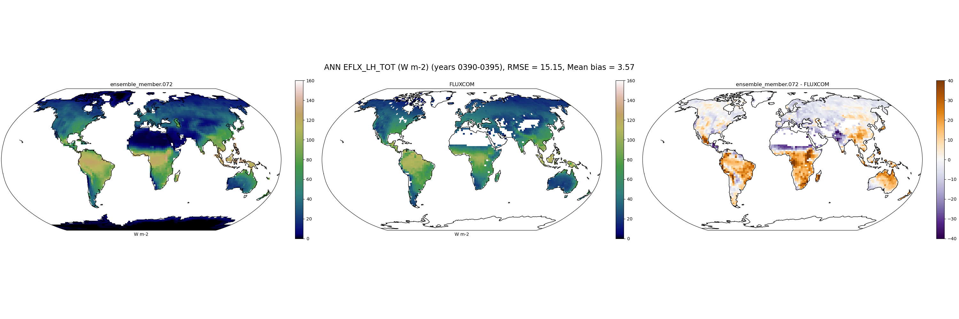
EFLX_LH_TOT_FLUXCOM
072

Slide 60
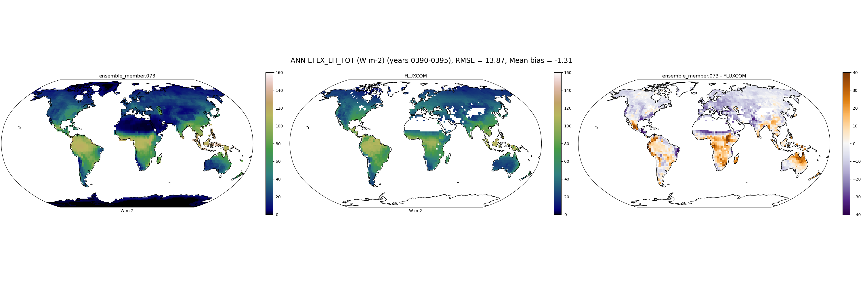
EFLX_LH_TOT_FLUXCOM
073

Slide 61
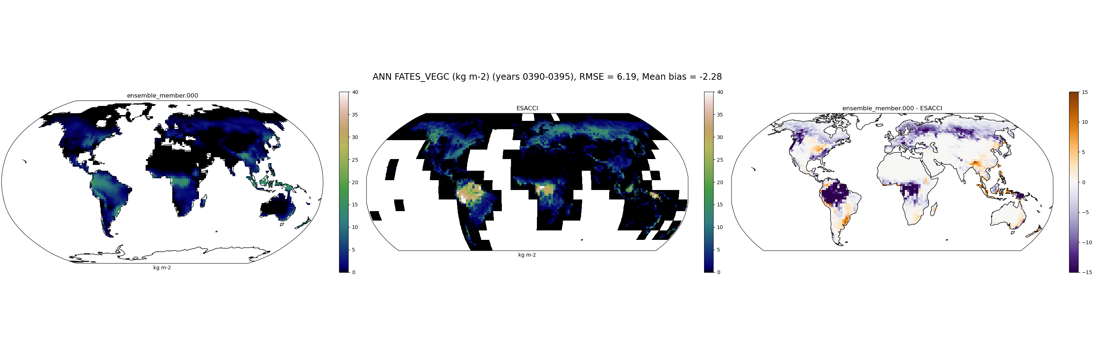
VEGC_ESACCI
000

Slide 62
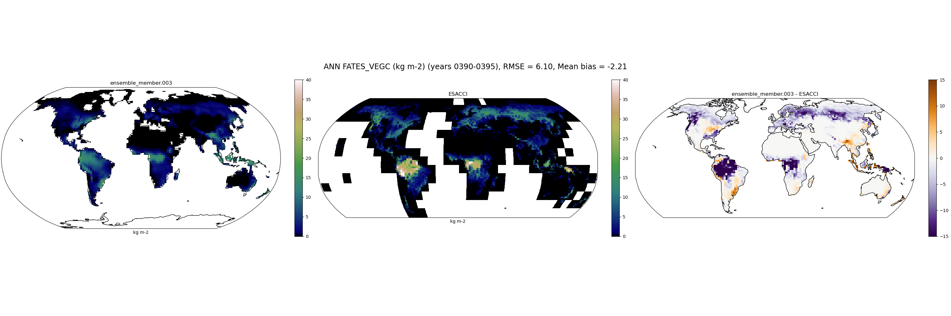
VEGC_ESACCI
003

Slide 63

VEGC_ESACCI
005

Slide 64

VEGC_ESACCI
009

Slide 65

VEGC_ESACCI
019

Slide 66

VEGC_ESACCI
021

Slide 67

VEGC_ESACCI
024

Slide 68

VEGC_ESACCI
030

Slide 69

VEGC_ESACCI
032

Slide 70

VEGC_ESACCI
039

Slide 71

VEGC_ESACCI
041

Slide 72

VEGC_ESACCI
042

Slide 73

VEGC_ESACCI
048

Slide 74

VEGC_ESACCI
058

Slide 75

VEGC_ESACCI
059

Slide 76

VEGC_ESACCI
064

Slide 77

VEGC_ESACCI
065

Slide 78

VEGC_ESACCI
069

Slide 79

VEGC_ESACCI
072

Slide 80

VEGC_ESACCI
073

Slide 81
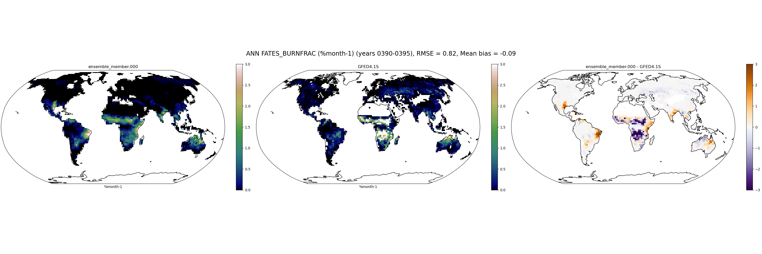
FATES_BURNFRAC_GFED
000

Slide 82

FATES_BURNFRAC_GFED
003

Slide 83

FATES_BURNFRAC_GFED
005

Slide 84

FATES_BURNFRAC_GFED
009

Slide 85
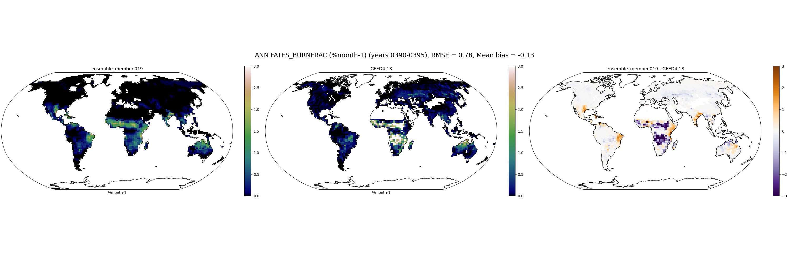
FATES_BURNFRAC_GFED
019

Slide 86

FATES_BURNFRAC_GFED
021

Slide 87

FATES_BURNFRAC_GFED
024

Slide 88

FATES_BURNFRAC_GFED
030

Slide 89

FATES_BURNFRAC_GFED
032

Slide 90

FATES_BURNFRAC_GFED
039

Slide 91

FATES_BURNFRAC_GFED
041

Slide 92

FATES_BURNFRAC_GFED
042

Slide 93

FATES_BURNFRAC_GFED
048

Slide 94

FATES_BURNFRAC_GFED
058

Slide 95

FATES_BURNFRAC_GFED
059

Slide 96

FATES_BURNFRAC_GFED
064

Slide 97

FATES_BURNFRAC_GFED
065

Slide 98

FATES_BURNFRAC_GFED
069

Slide 99

FATES_BURNFRAC_GFED
072

Slide 100

FATES_BURNFRAC_GFED
073

Slide 101
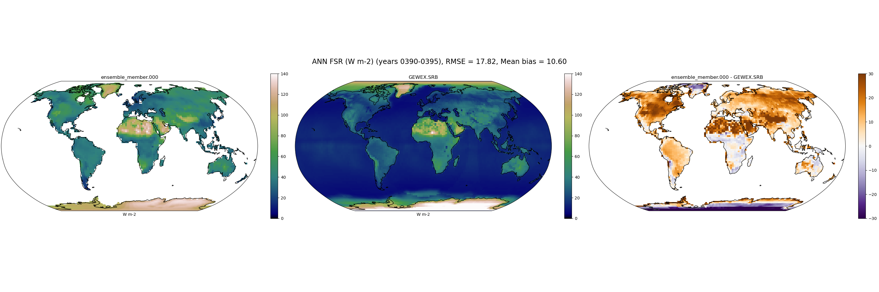
FSR_GEWEX.SRB
000

Slide 102

FSR_GEWEX.SRB
003

Slide 103
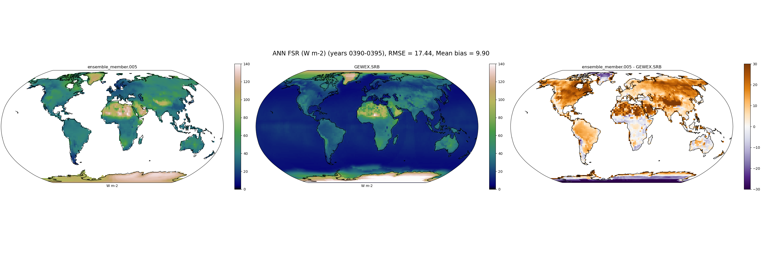
FSR_GEWEX.SRB
005

Slide 104

FSR_GEWEX.SRB
009

Slide 105
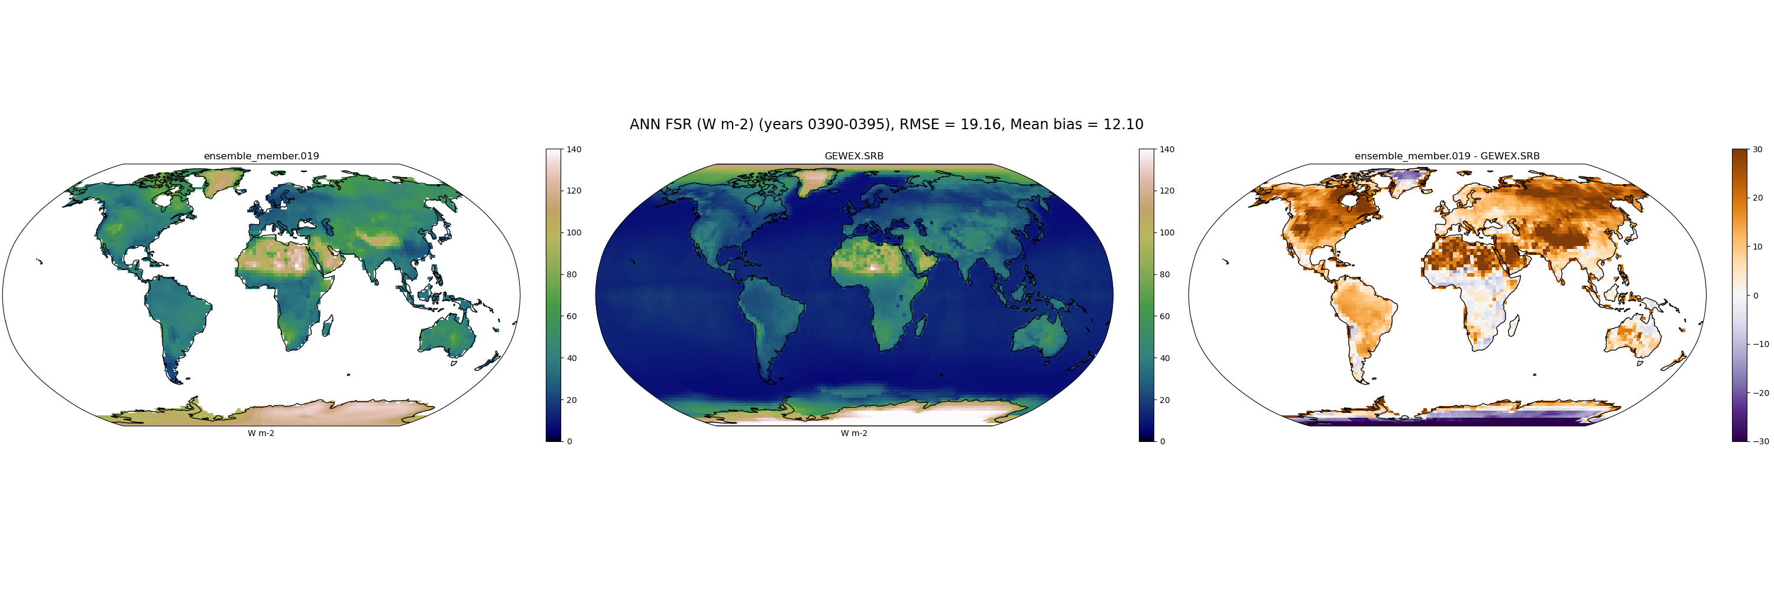
FSR_GEWEX.SRB
019

Slide 106
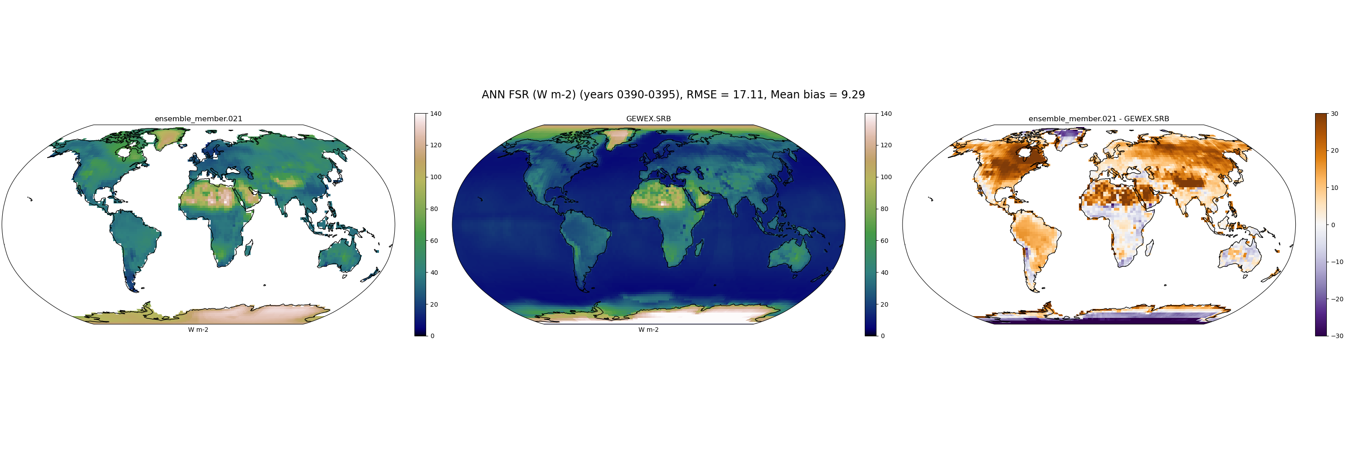
FSR_GEWEX.SRB
021

Slide 107
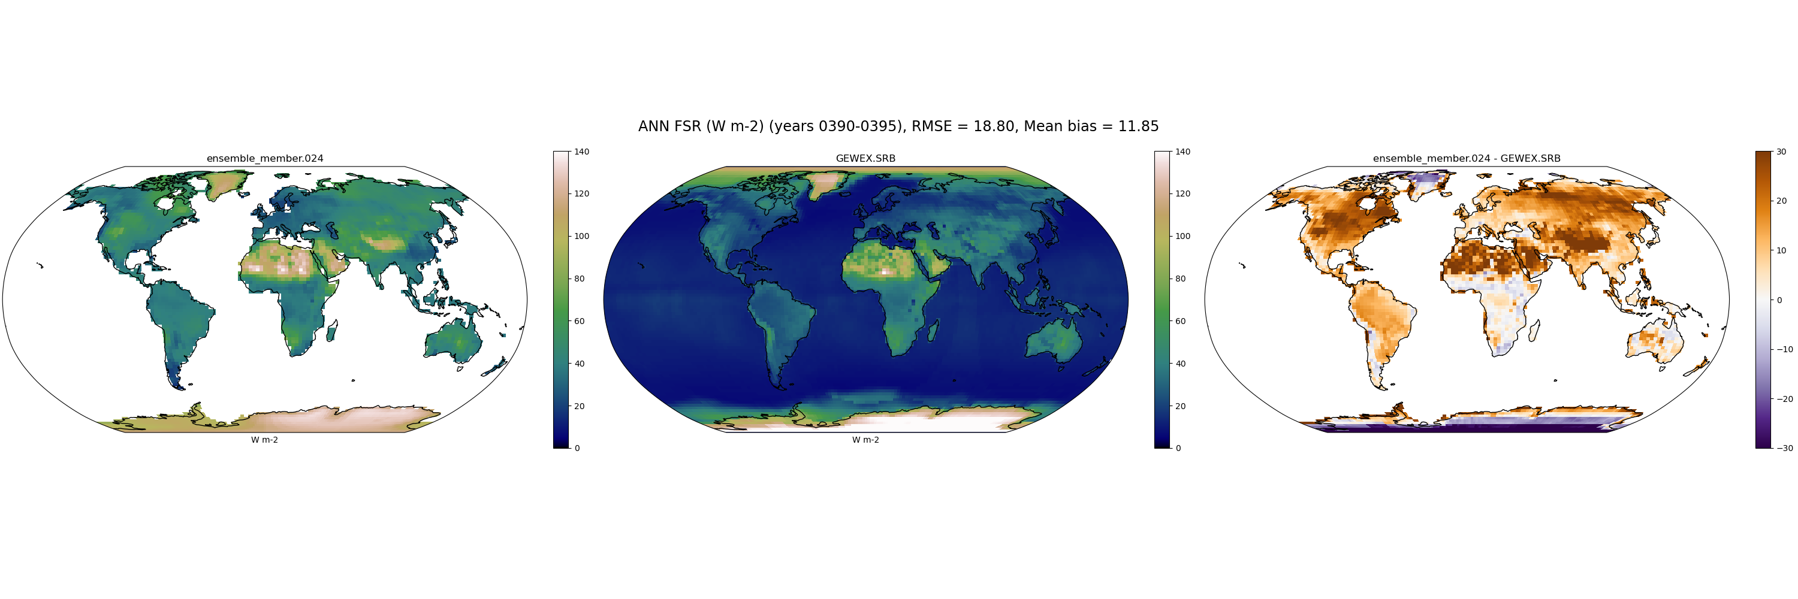
FSR_GEWEX.SRB
024

Slide 108

FSR_GEWEX.SRB
030

Slide 109

FSR_GEWEX.SRB
032

Slide 110

FSR_GEWEX.SRB
039

Slide 111
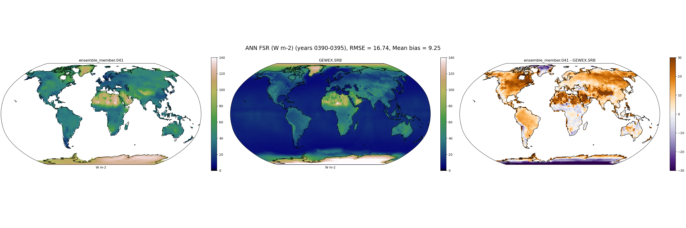
FSR_GEWEX.SRB
041

Slide 112

FSR_GEWEX.SRB
042

Slide 113

FSR_GEWEX.SRB
048

Slide 114

FSR_GEWEX.SRB
058

Slide 115

FSR_GEWEX.SRB
059

Slide 116

FSR_GEWEX.SRB
064

Slide 117

FSR_GEWEX.SRB
065

Slide 118
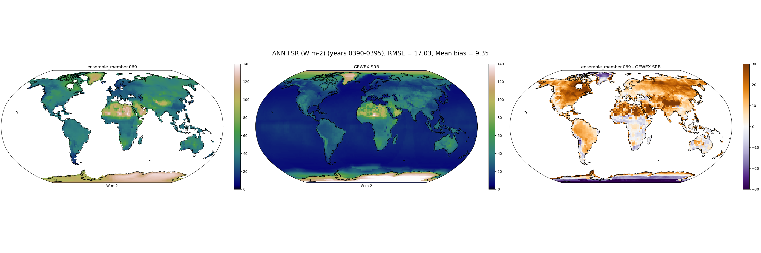
FSR_GEWEX.SRB
069

Slide 119

FSR_GEWEX.SRB
072

Slide 120
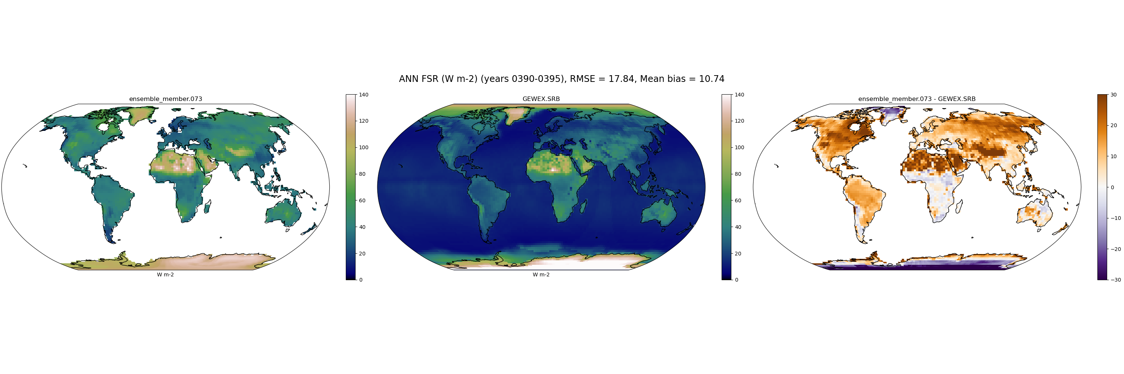
FSR_GEWEX.SRB
073

Slide 121
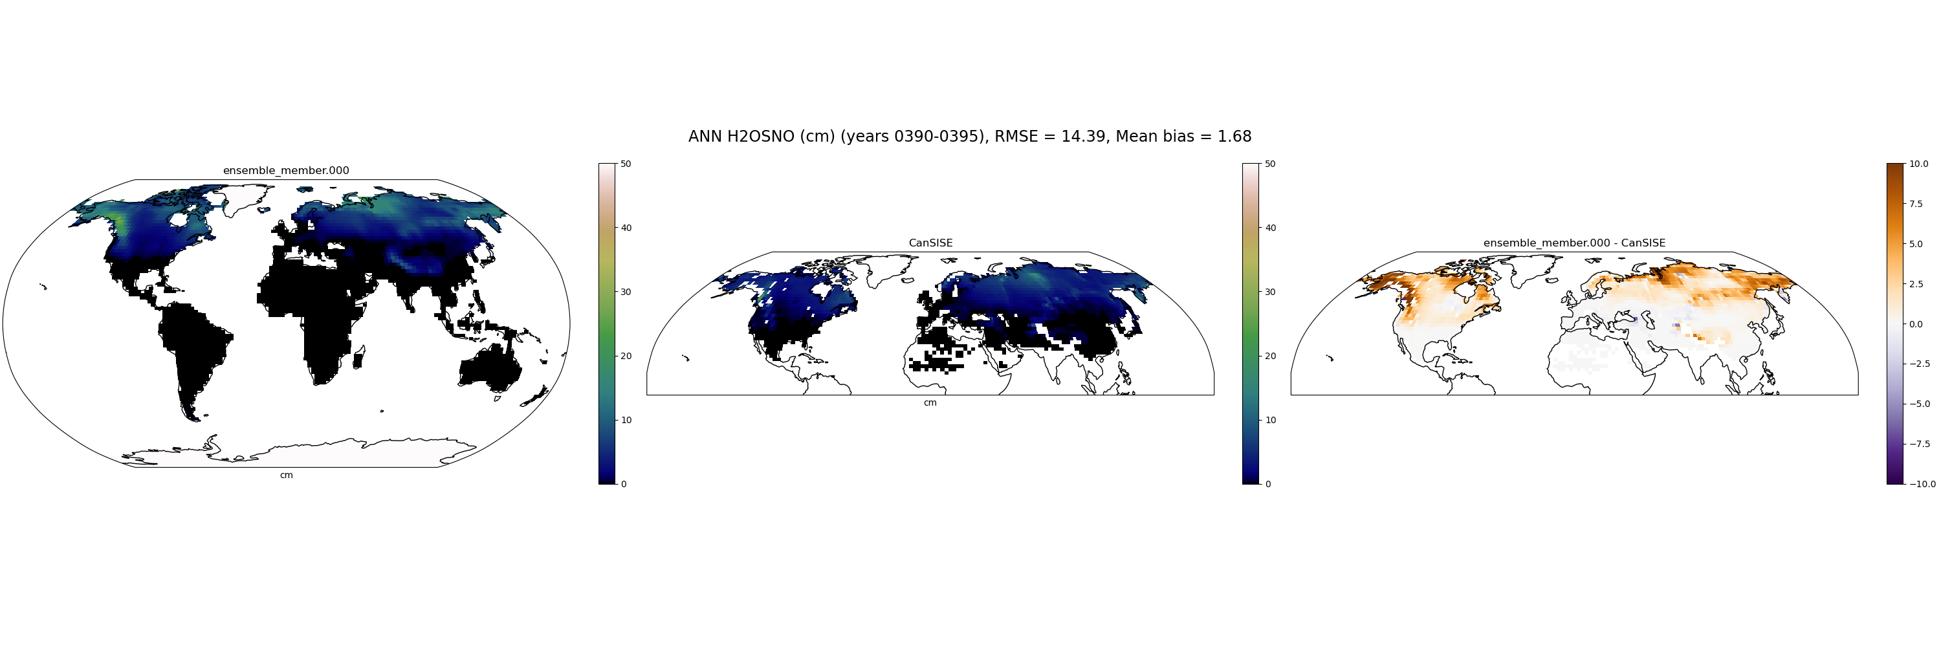
H2OSNO_CanSISE
000

Slide 122

H2OSNO_CanSISE
003

Slide 123

H2OSNO_CanSISE
005

Slide 124

H2OSNO_CanSISE
009

Slide 125

H2OSNO_CanSISE
019

Slide 126

H2OSNO_CanSISE
021

Slide 127

H2OSNO_CanSISE
024

Slide 128

H2OSNO_CanSISE
030

Slide 129

H2OSNO_CanSISE
032

Slide 130

H2OSNO_CanSISE
039

Slide 131

H2OSNO_CanSISE
041

Slide 132

H2OSNO_CanSISE
042

Slide 133

H2OSNO_CanSISE
048

Slide 134

H2OSNO_CanSISE
058

Slide 135

H2OSNO_CanSISE
059

Slide 136

H2OSNO_CanSISE
064

Slide 137

H2OSNO_CanSISE
065

Slide 138

H2OSNO_CanSISE
069

Slide 139

H2OSNO_CanSISE
072

Slide 140

H2OSNO_CanSISE
073

Slide 141
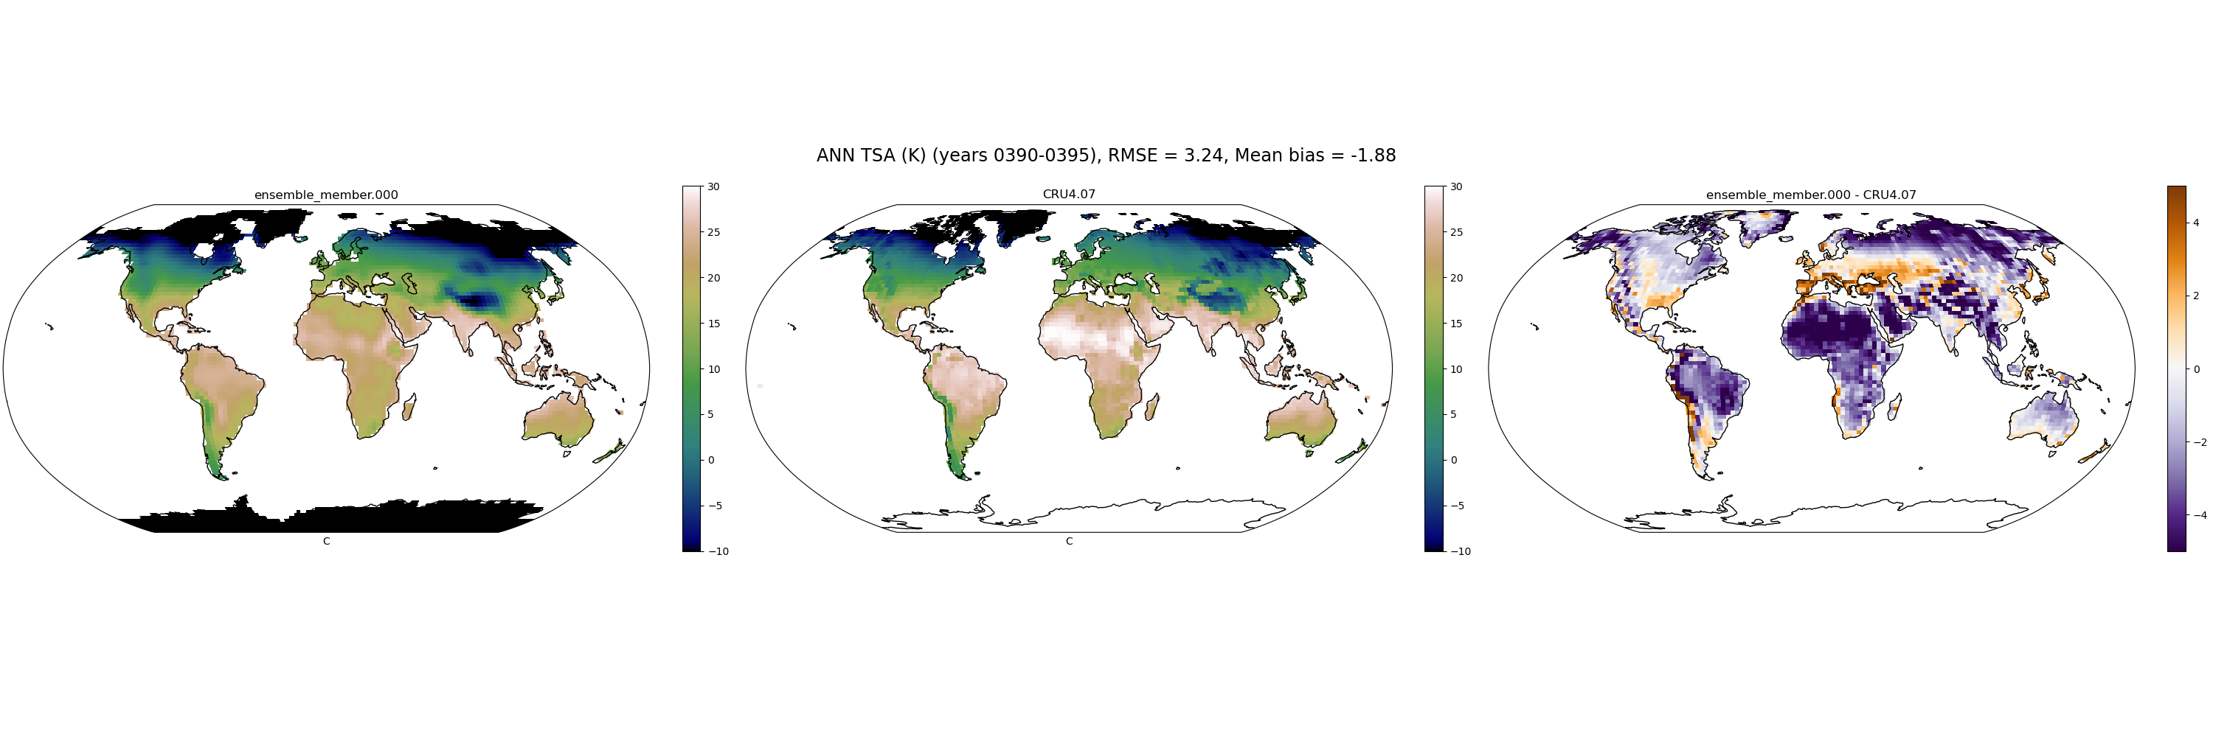
TSA_CRU4.07
000

Slide 142
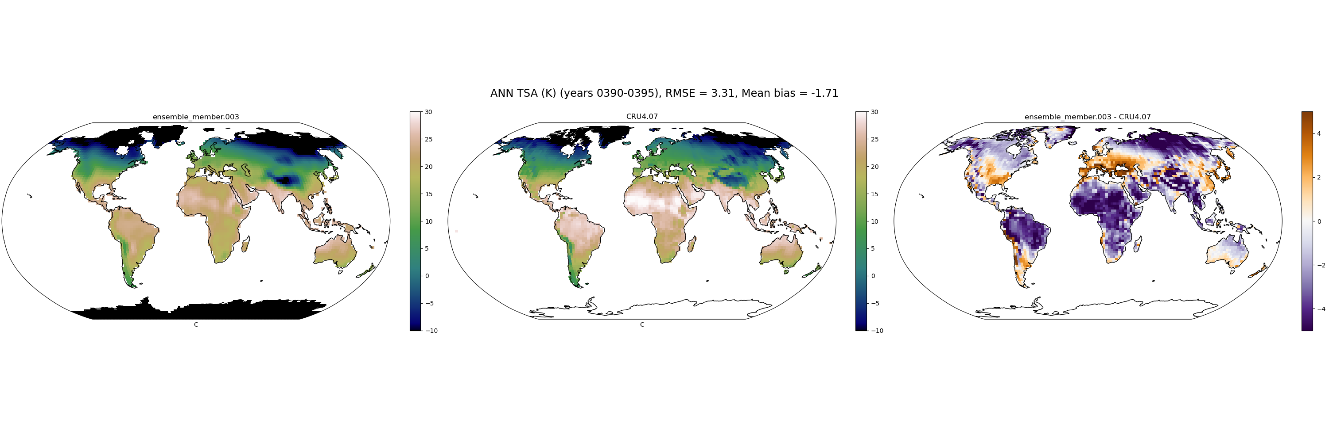
TSA_CRU4.07
003

Slide 143
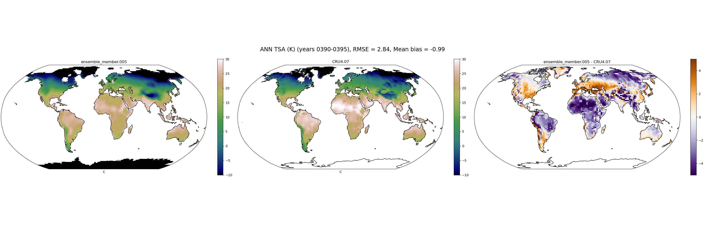
TSA_CRU4.07
005

Slide 144
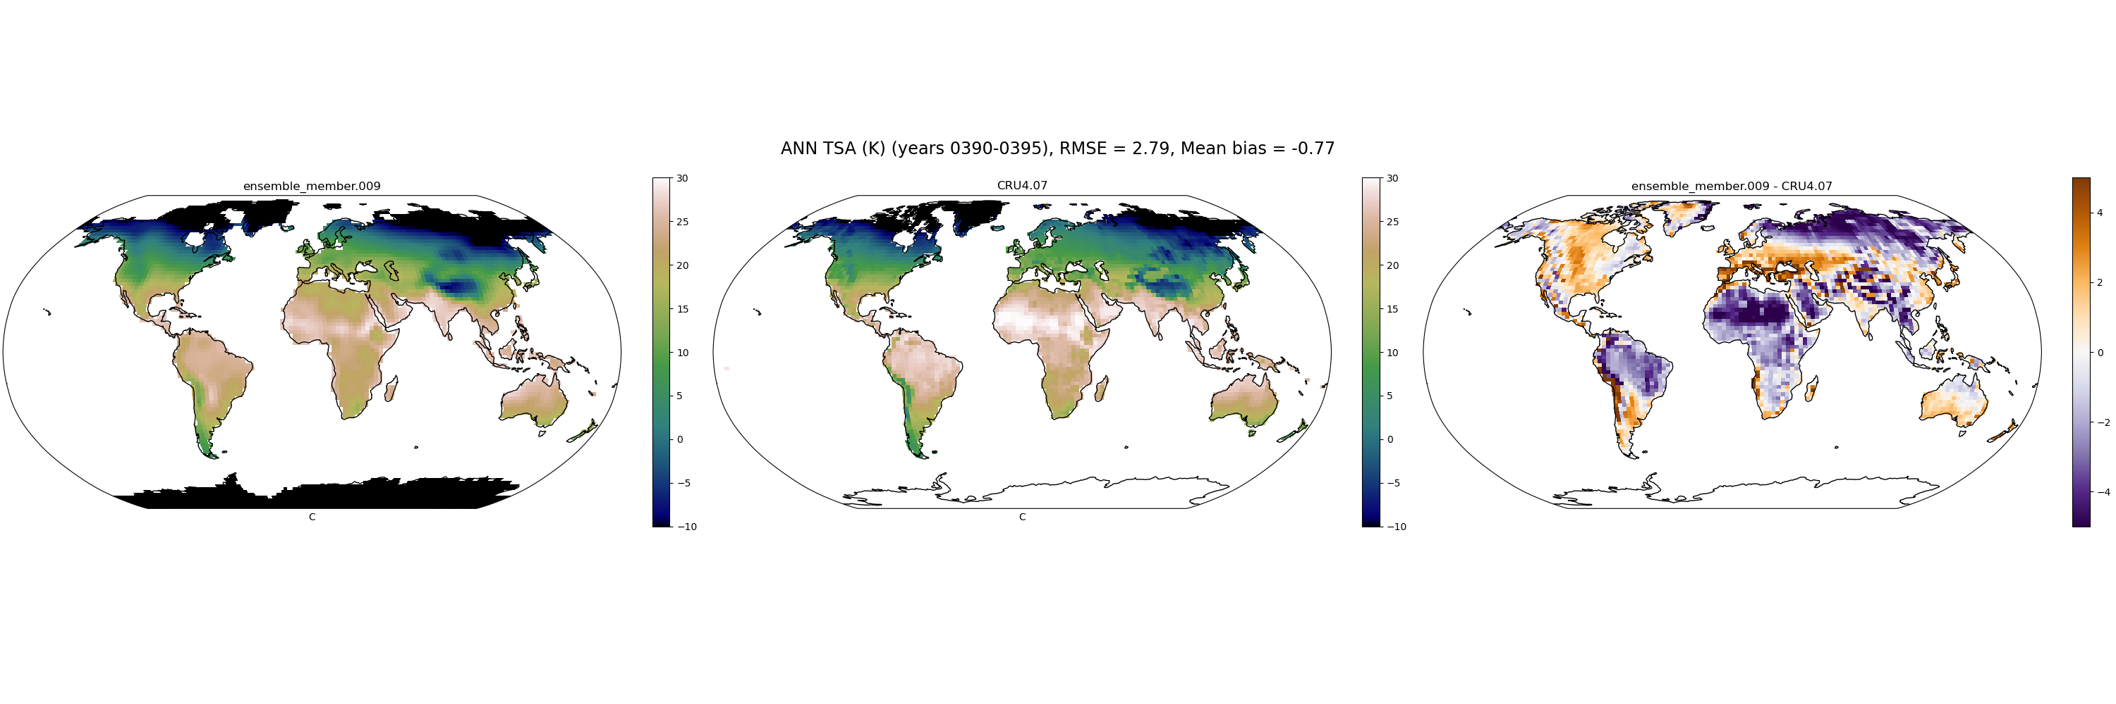
TSA_CRU4.07
009

Slide 145
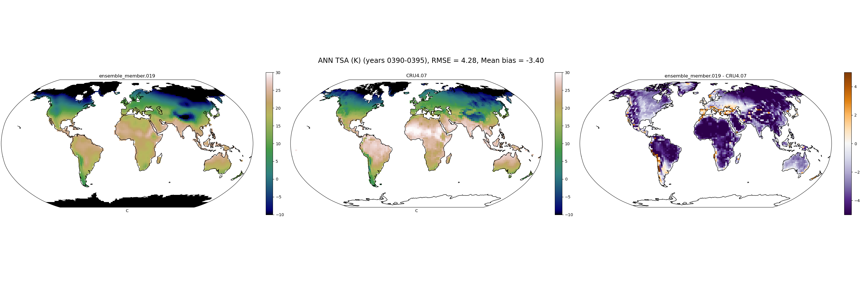
TSA_CRU4.07
019

Slide 146
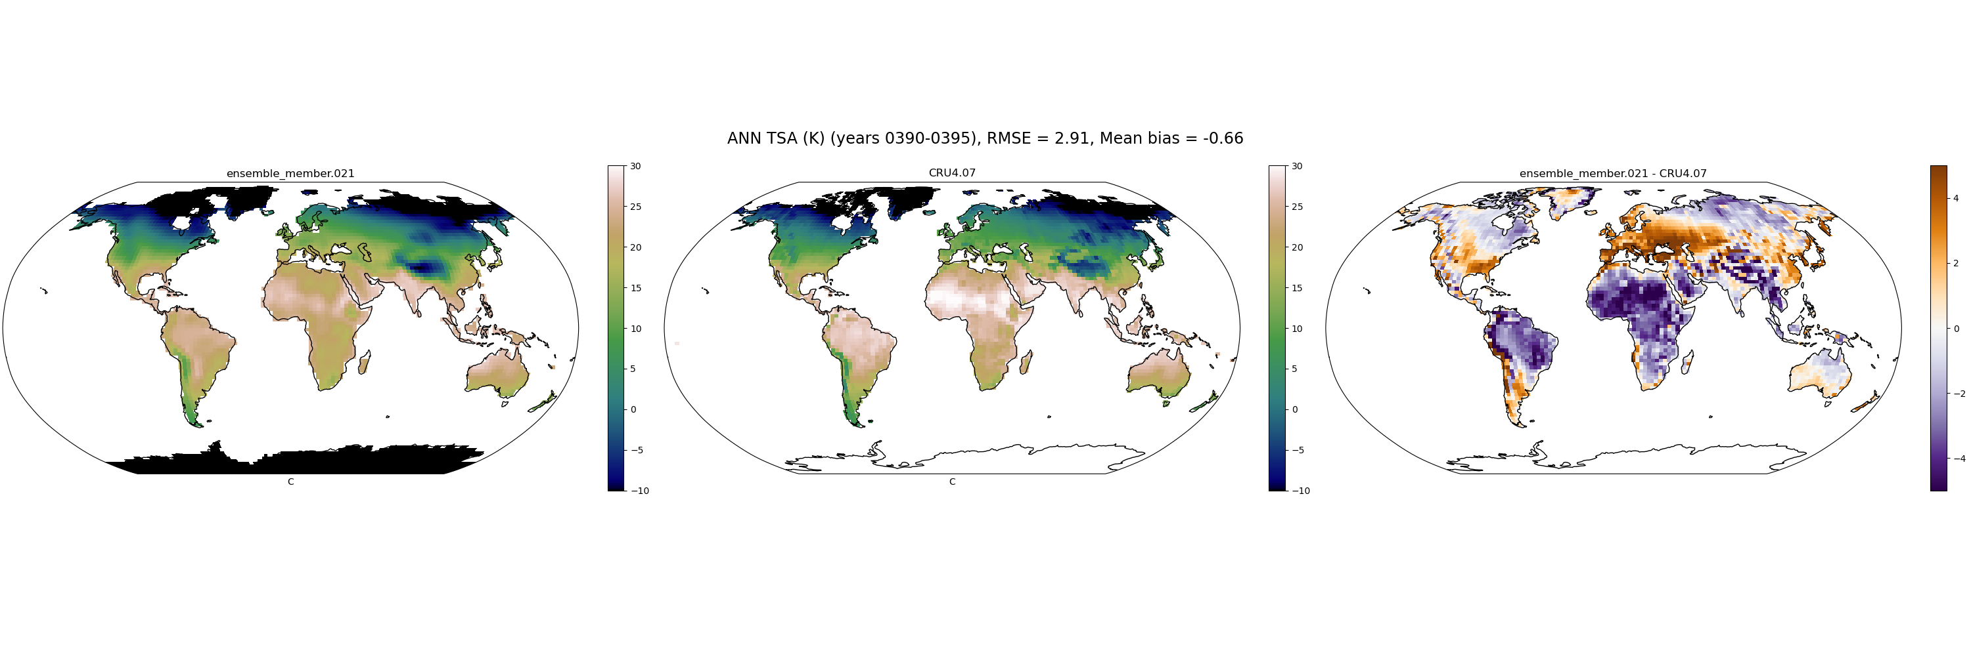
TSA_CRU4.07
021

Slide 147
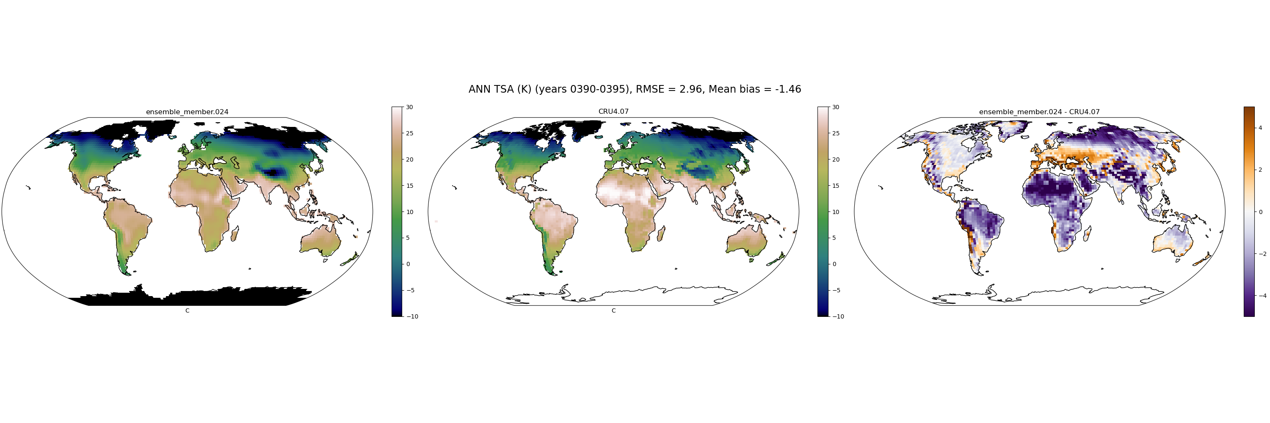
TSA_CRU4.07
024

Slide 148
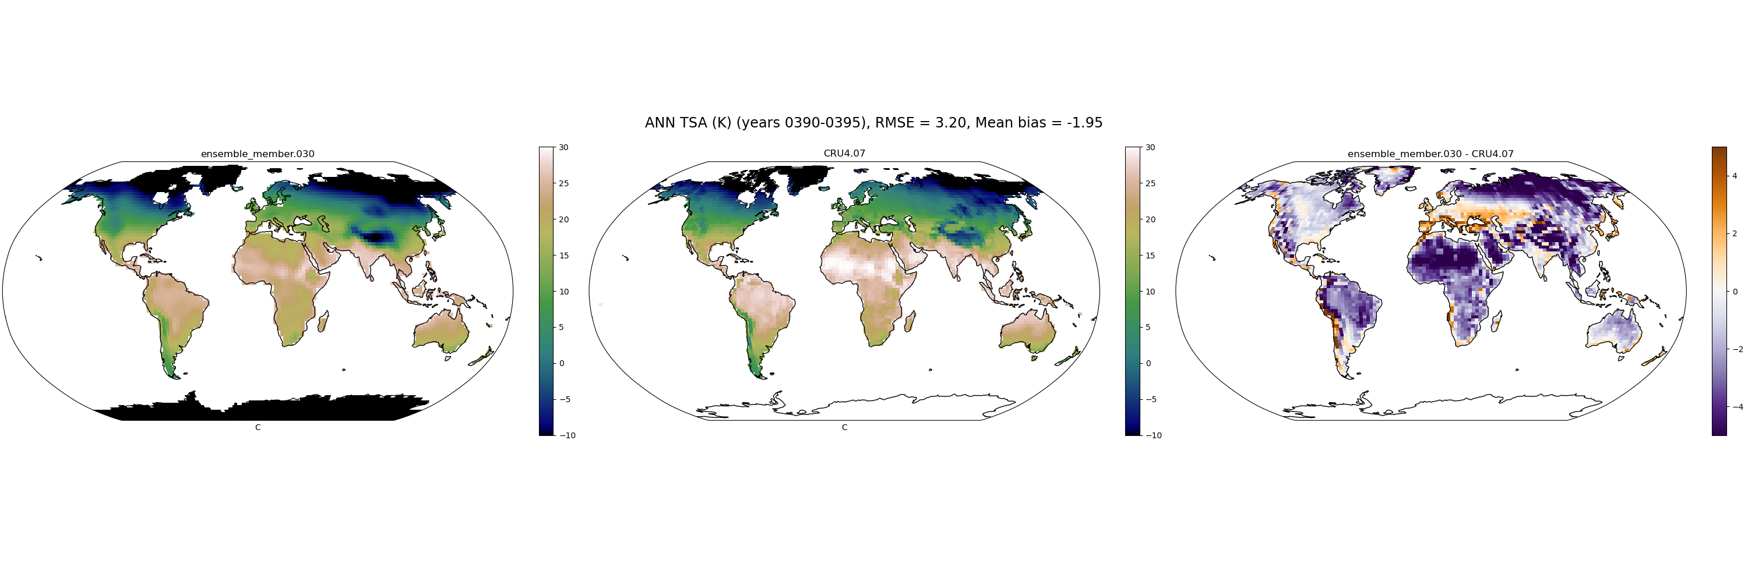
TSA_CRU4.07
030

Slide 149

TSA_CRU4.07
032

Slide 150
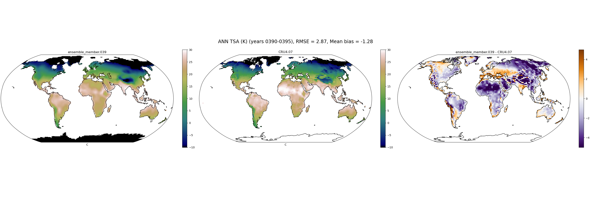
TSA_CRU4.07
039

Slide 151
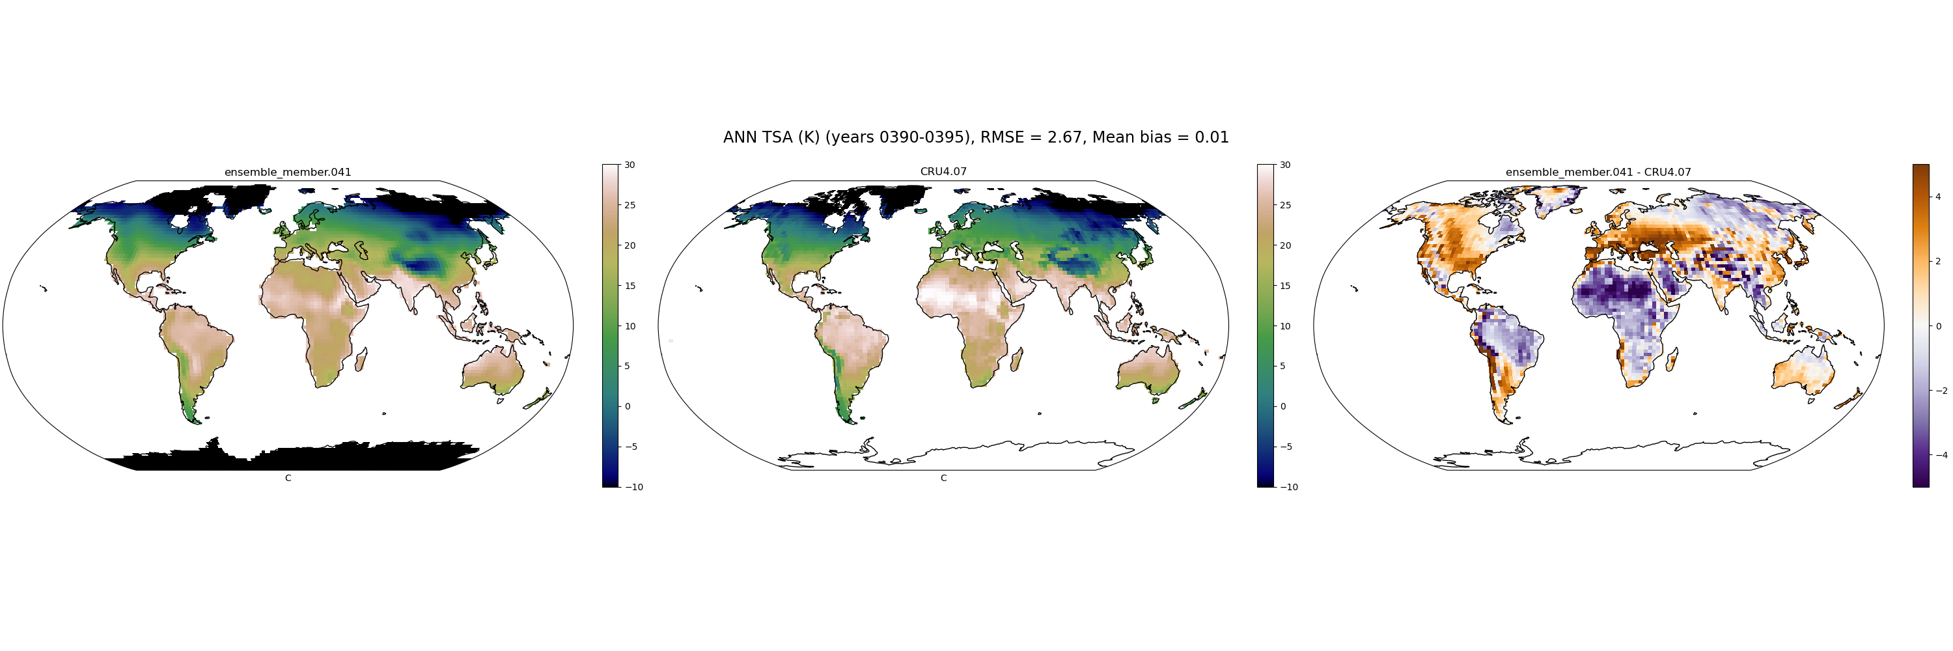
TSA_CRU4.07
041

Slide 152
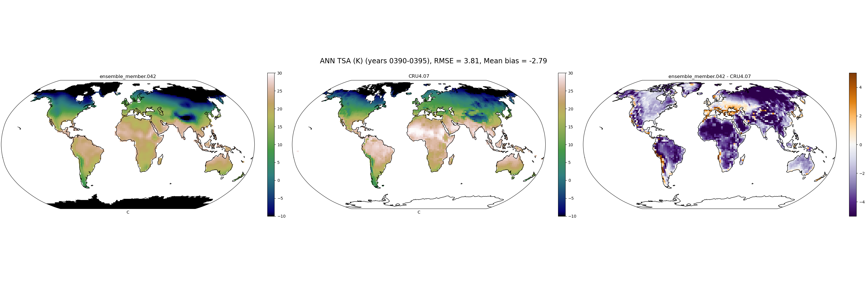
TSA_CRU4.07
042

Slide 153
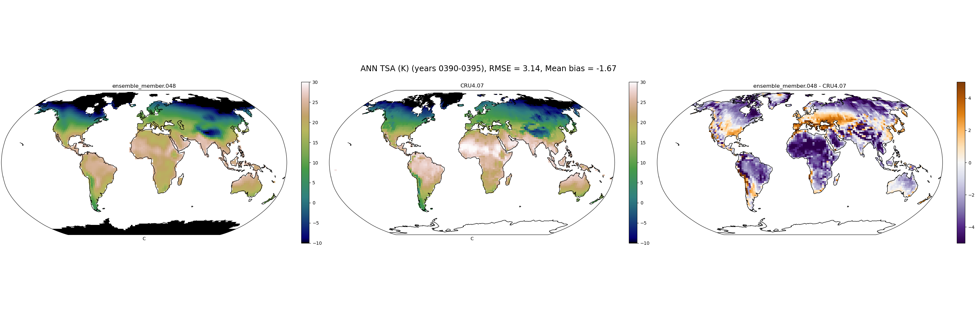
TSA_CRU4.07
048

Slide 154

TSA_CRU4.07
058

Slide 155
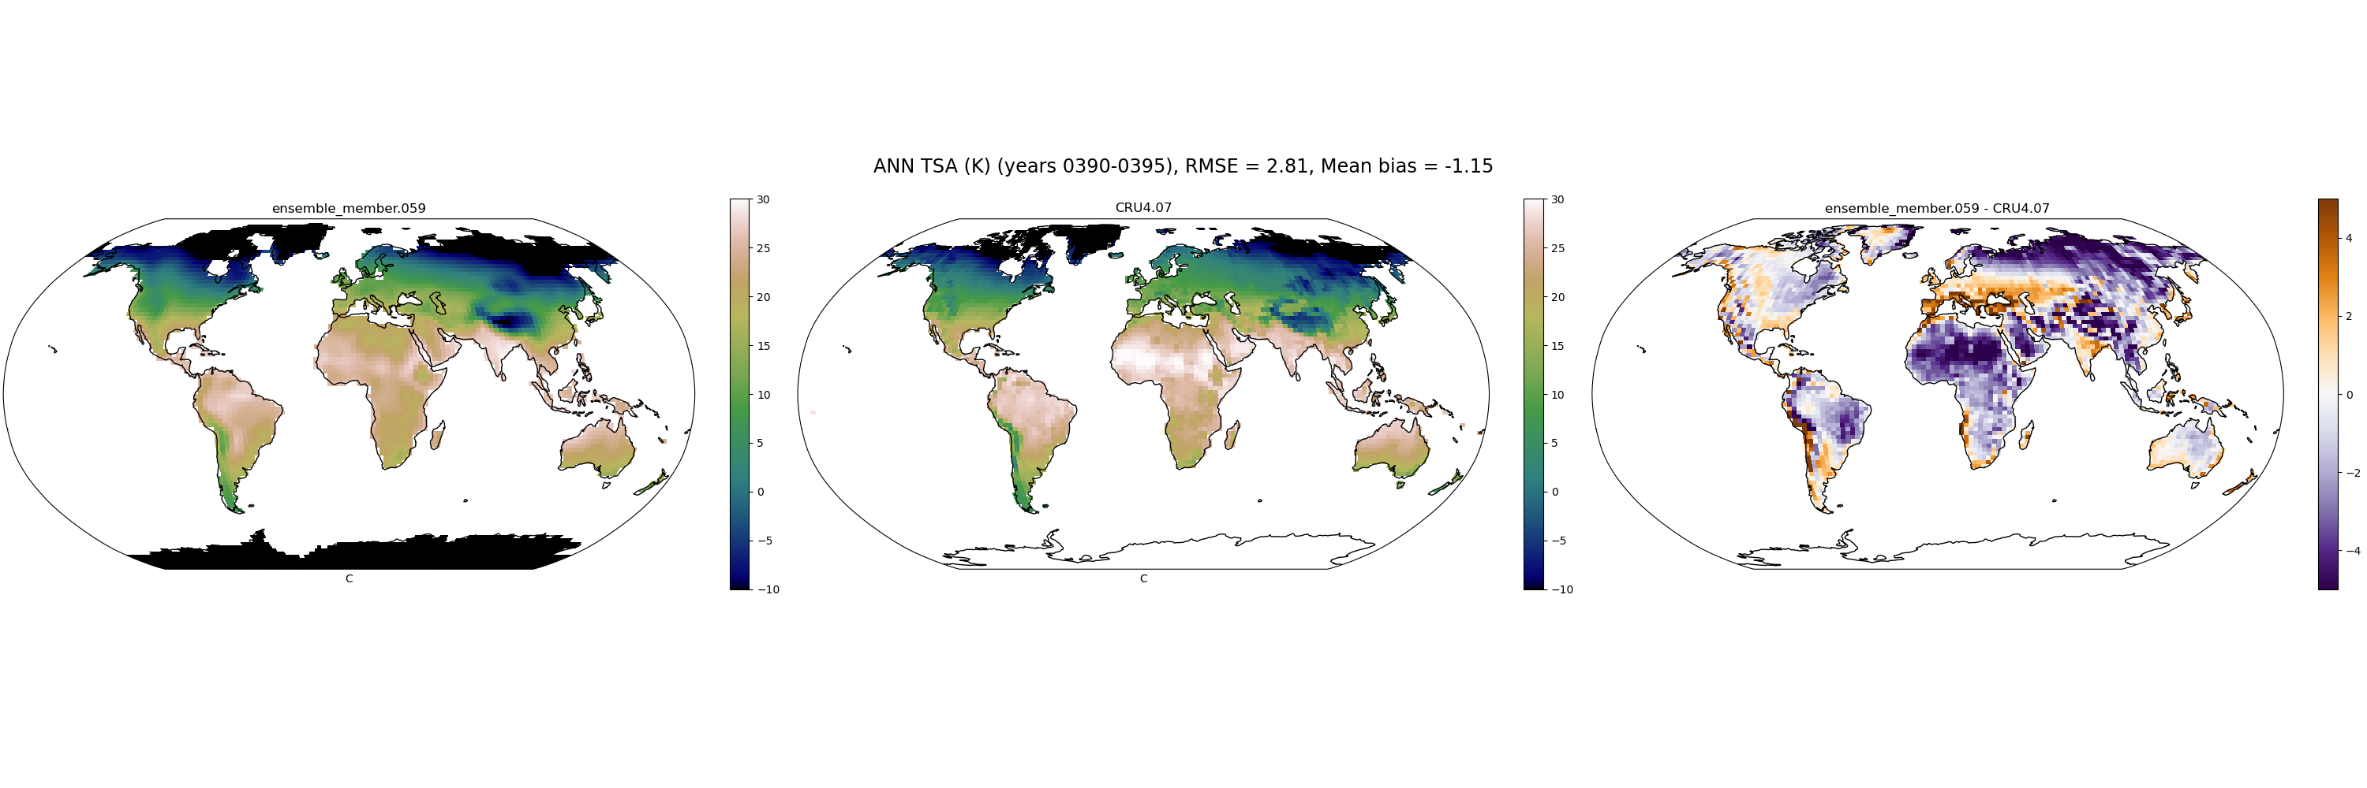
TSA_CRU4.07
059

Slide 156
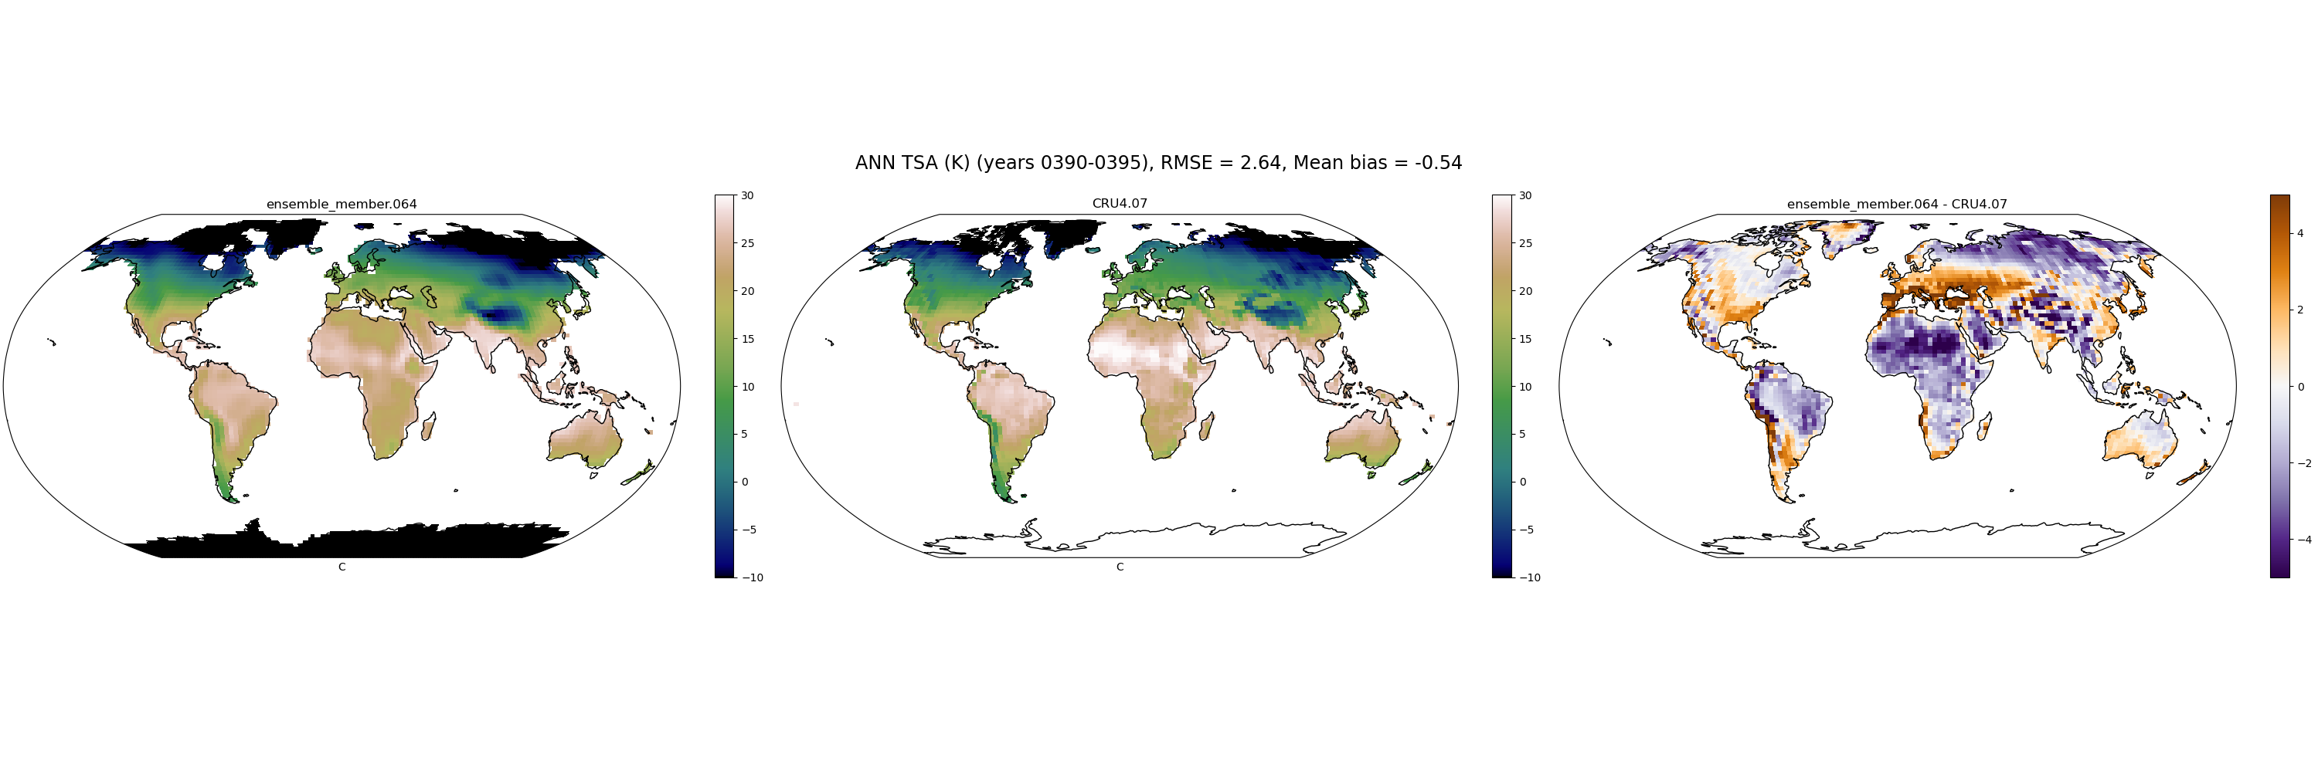
TSA_CRU4.07
064

Slide 157
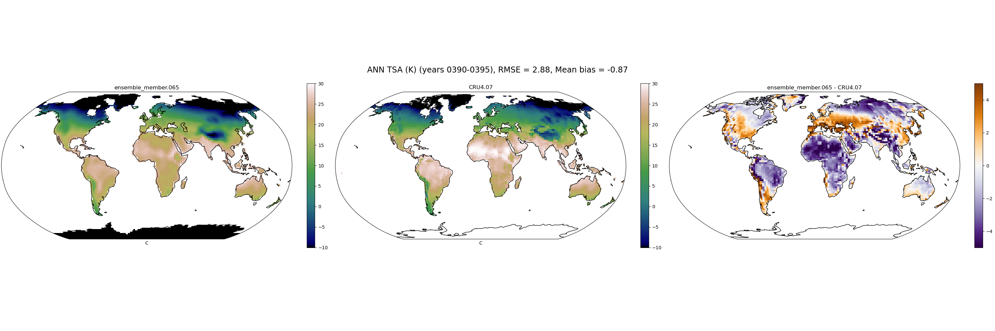
TSA_CRU4.07
065

Slide 158

TSA_CRU4.07
069

Slide 159

TSA_CRU4.07
072

Slide 160

TSA_CRU4.07
073

